Slide 1
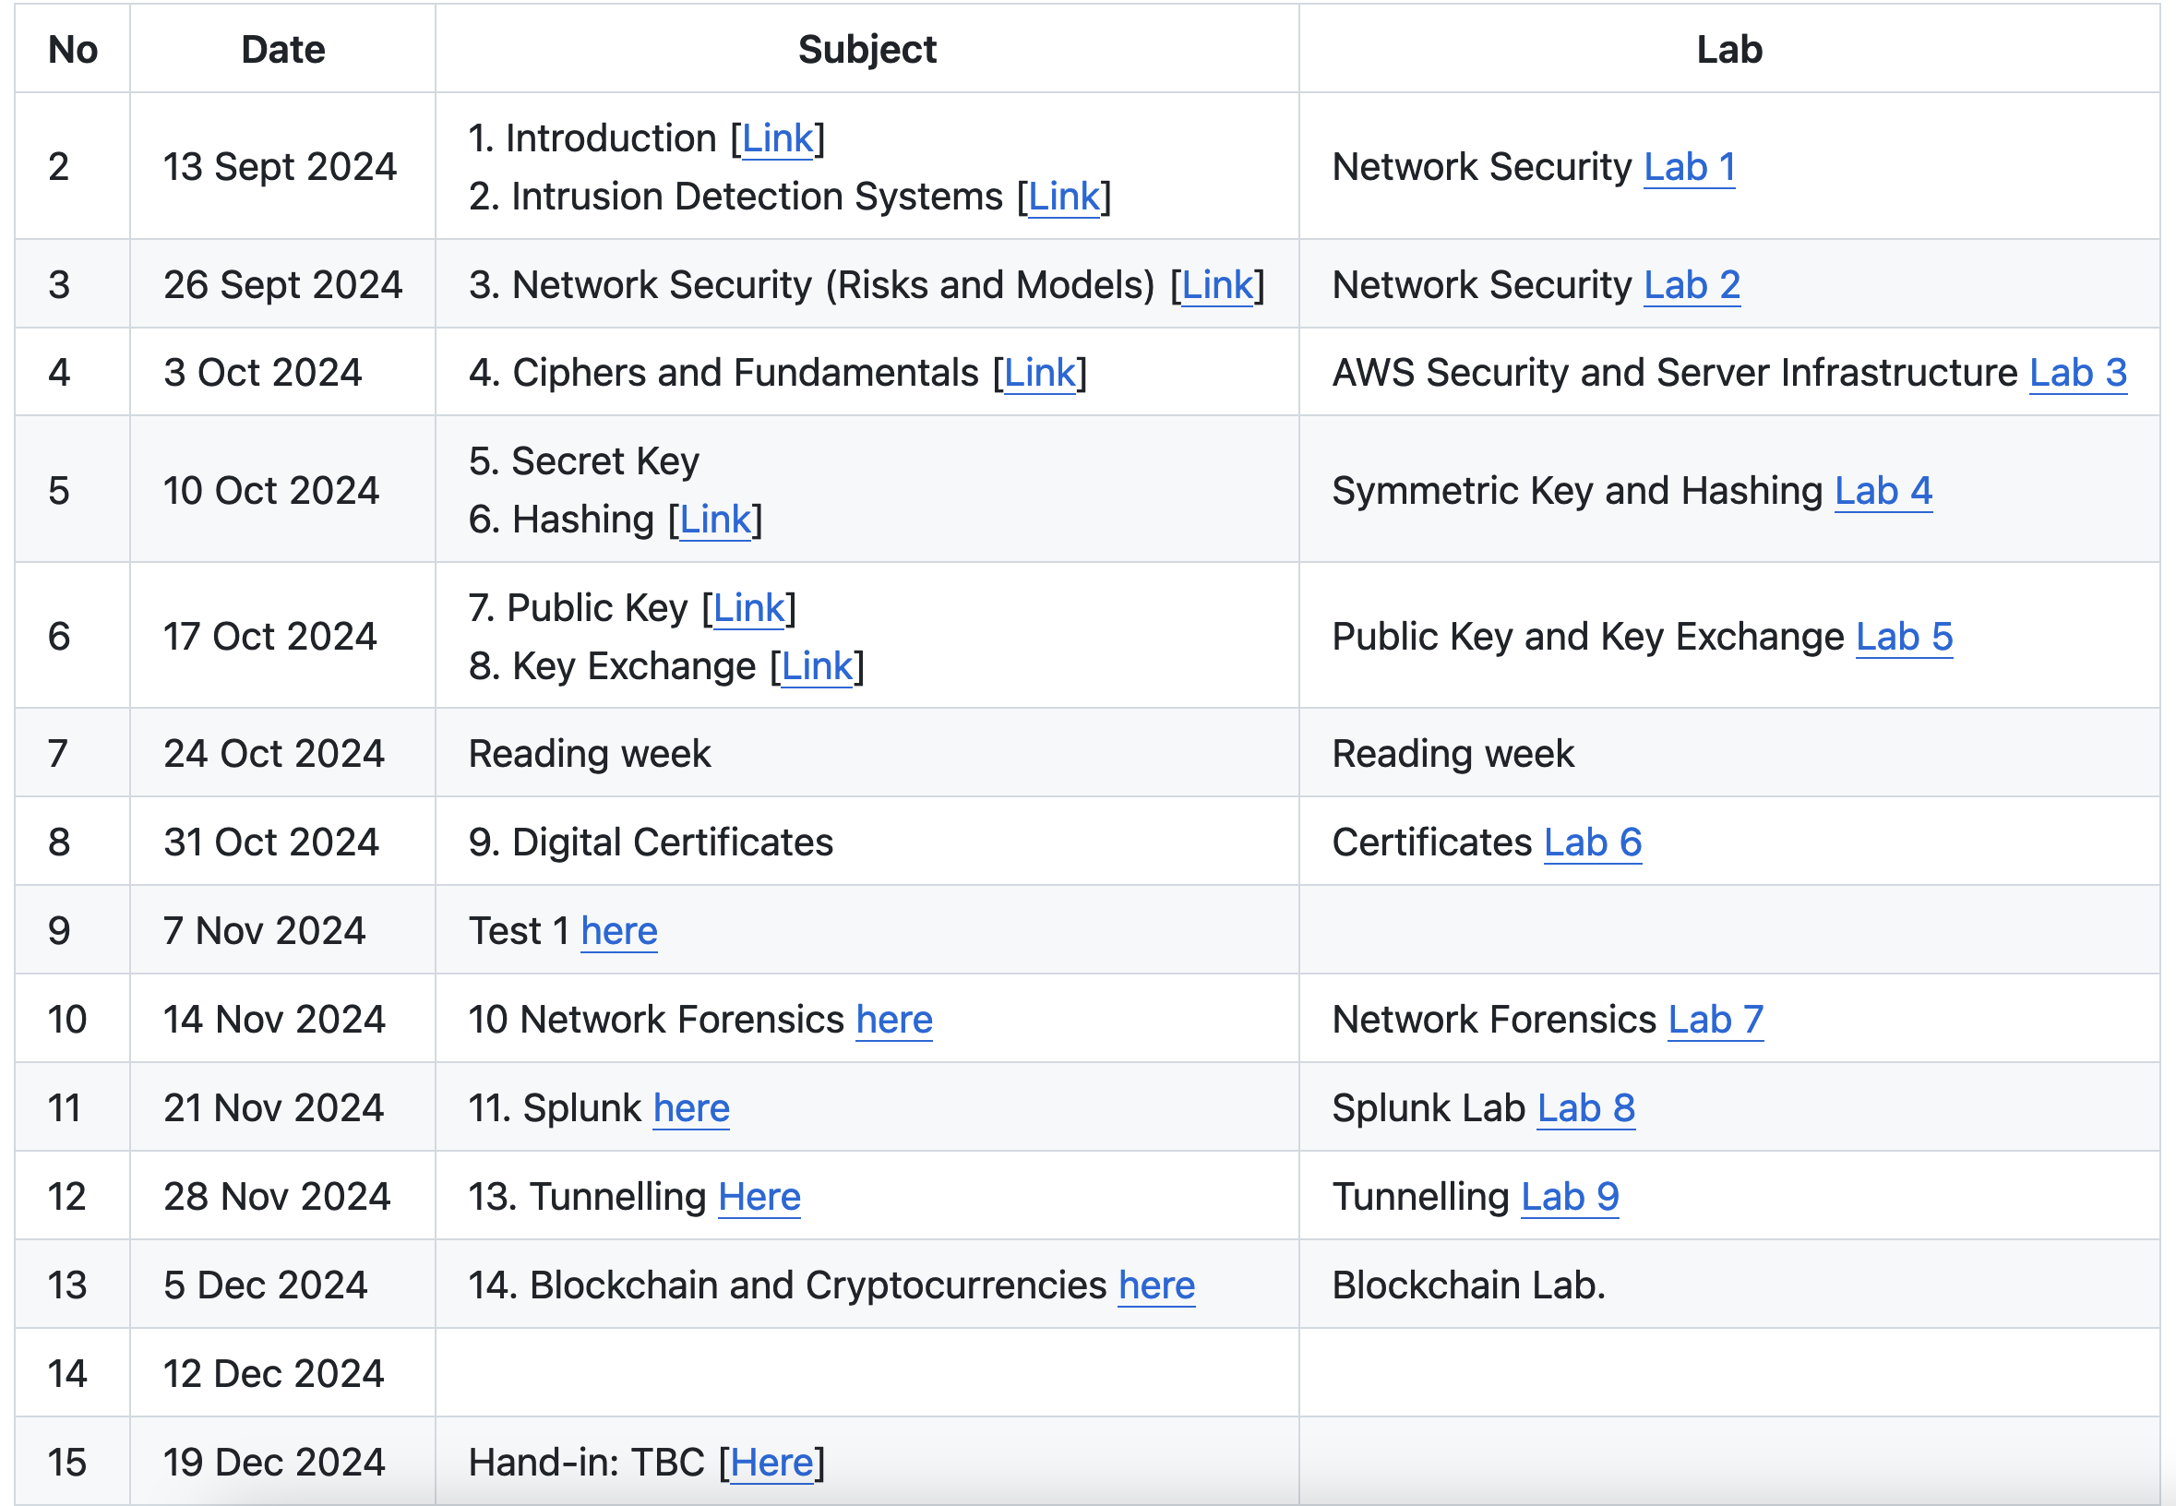

Network Security (Risks and Models)
“From bits to information”

Slide 2

Outline
Basics: Security Policy, Risk and Benefits.
Kill Chain Model, MITRE ATT&CK and EMB3D.
Basic Terms: Defence in Depth, IDS.
Cryptography Basics.
Secure Infrastructures.
Secure Enclaves.
Network Security: NAT, Stateful Firewalls.
AI Threats.

Slide 3
Introduction
“From bits to information”

Slide 4
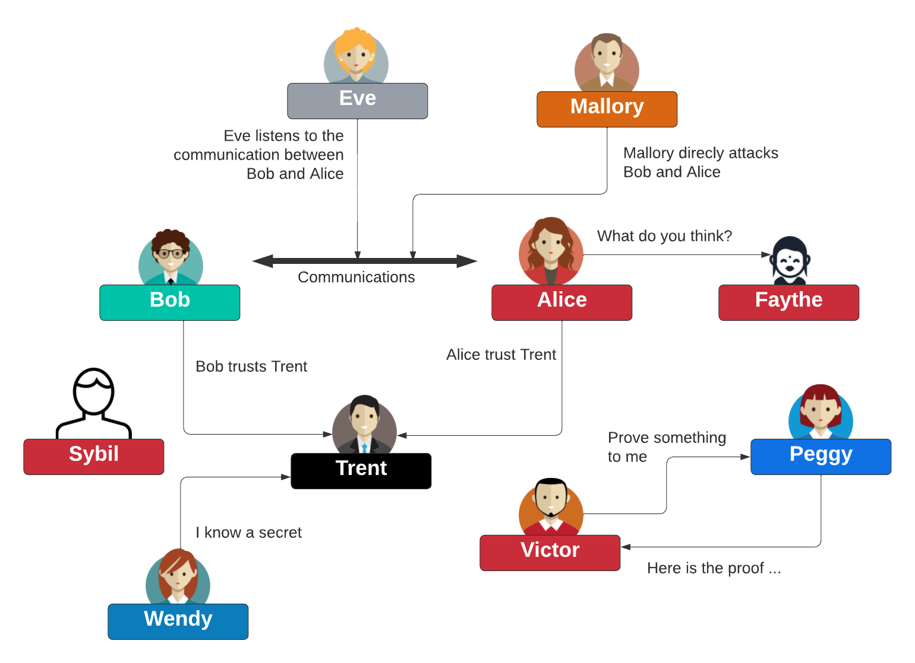
Bob, Alice and Eve

Slide 5
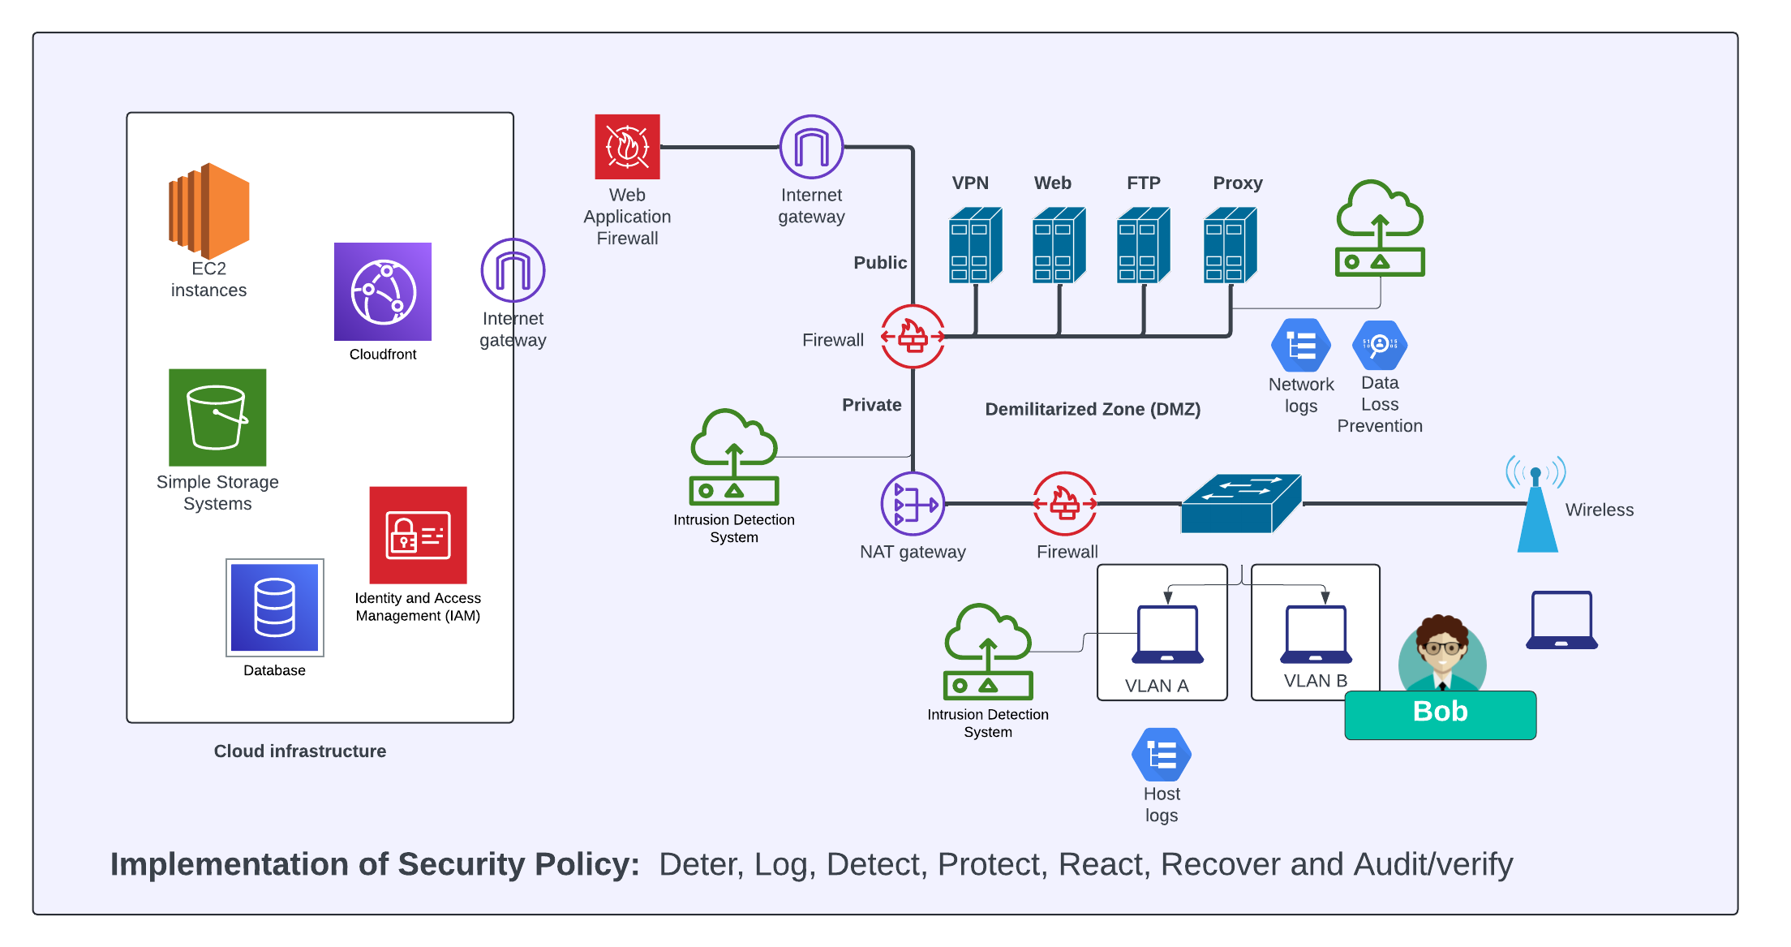
Information Security

Slide 6
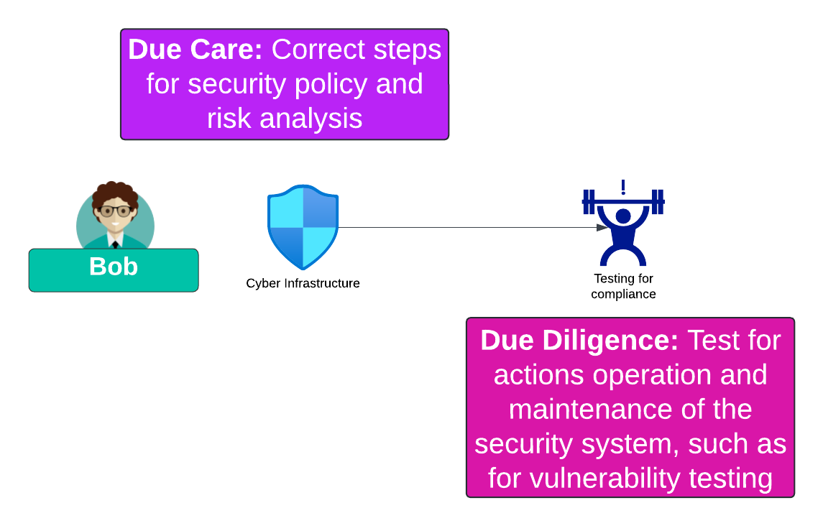
Due Care and Due Diligence

Slide 7
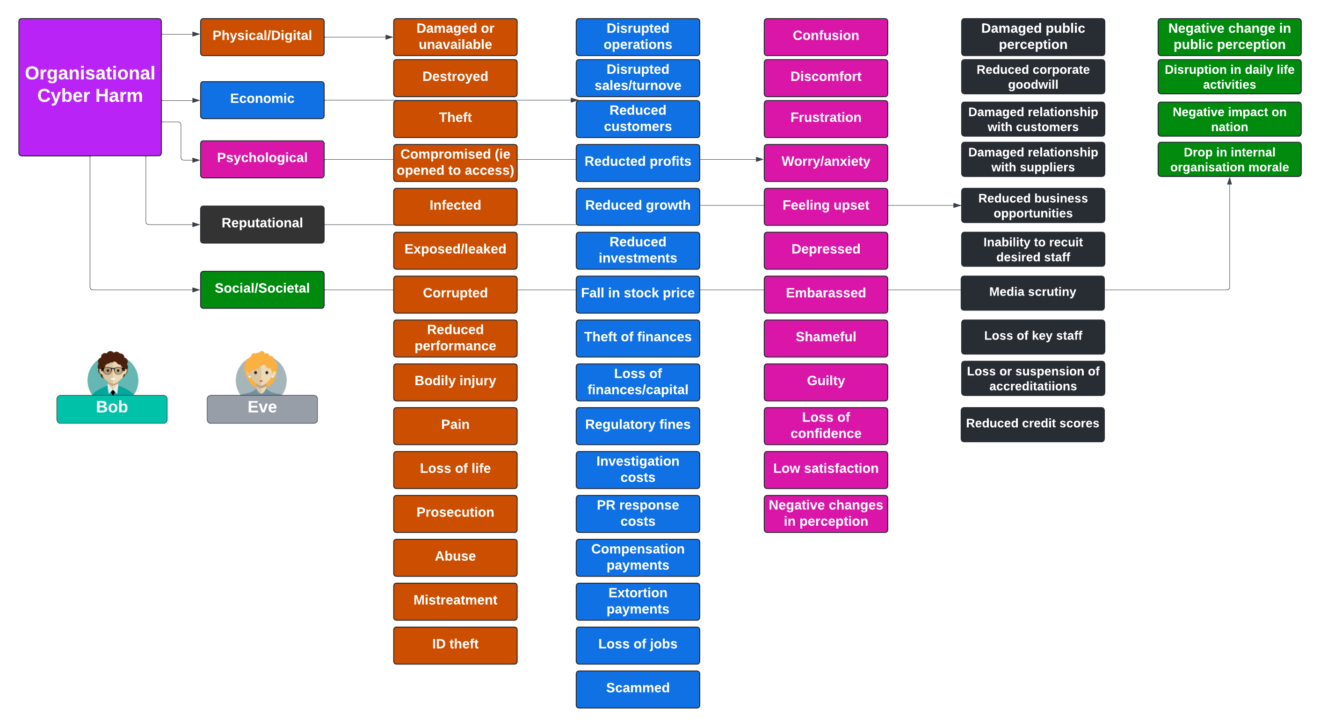
Impact and Harm
Agrafiotis, I., Nurse, J. R., Goldsmith, M., Creese, S., & Upton, D. (2018). A taxonomy of cyber-harms: Defining the impacts of cyber-attacks and understanding how they propagate. Journal of Cybersecurity, 4(1), tyy006.

Slide 8
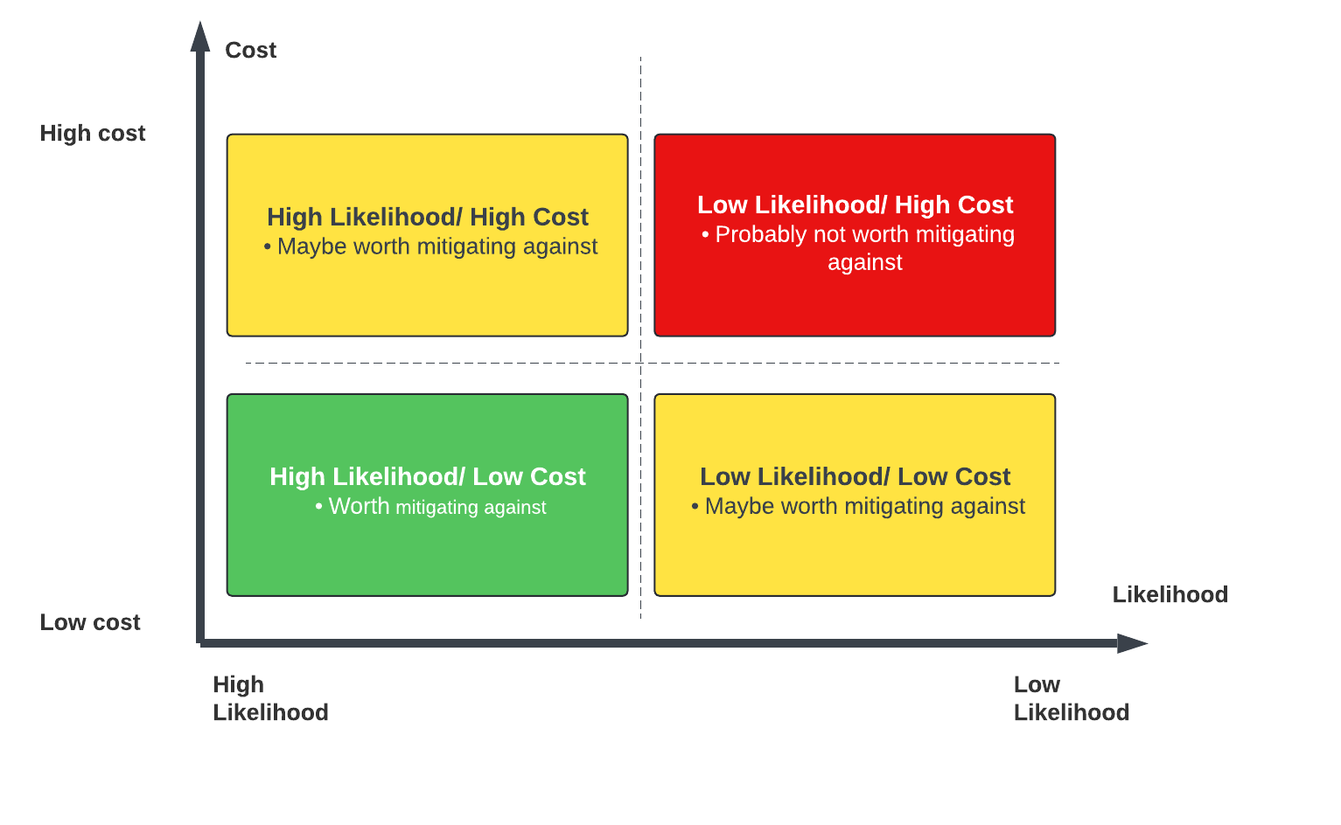
Risks, Costs and Benefits
ALE = AV x ARO
ALE – Annual Loss Expectancy.
AV – Asset Value

Slide 9
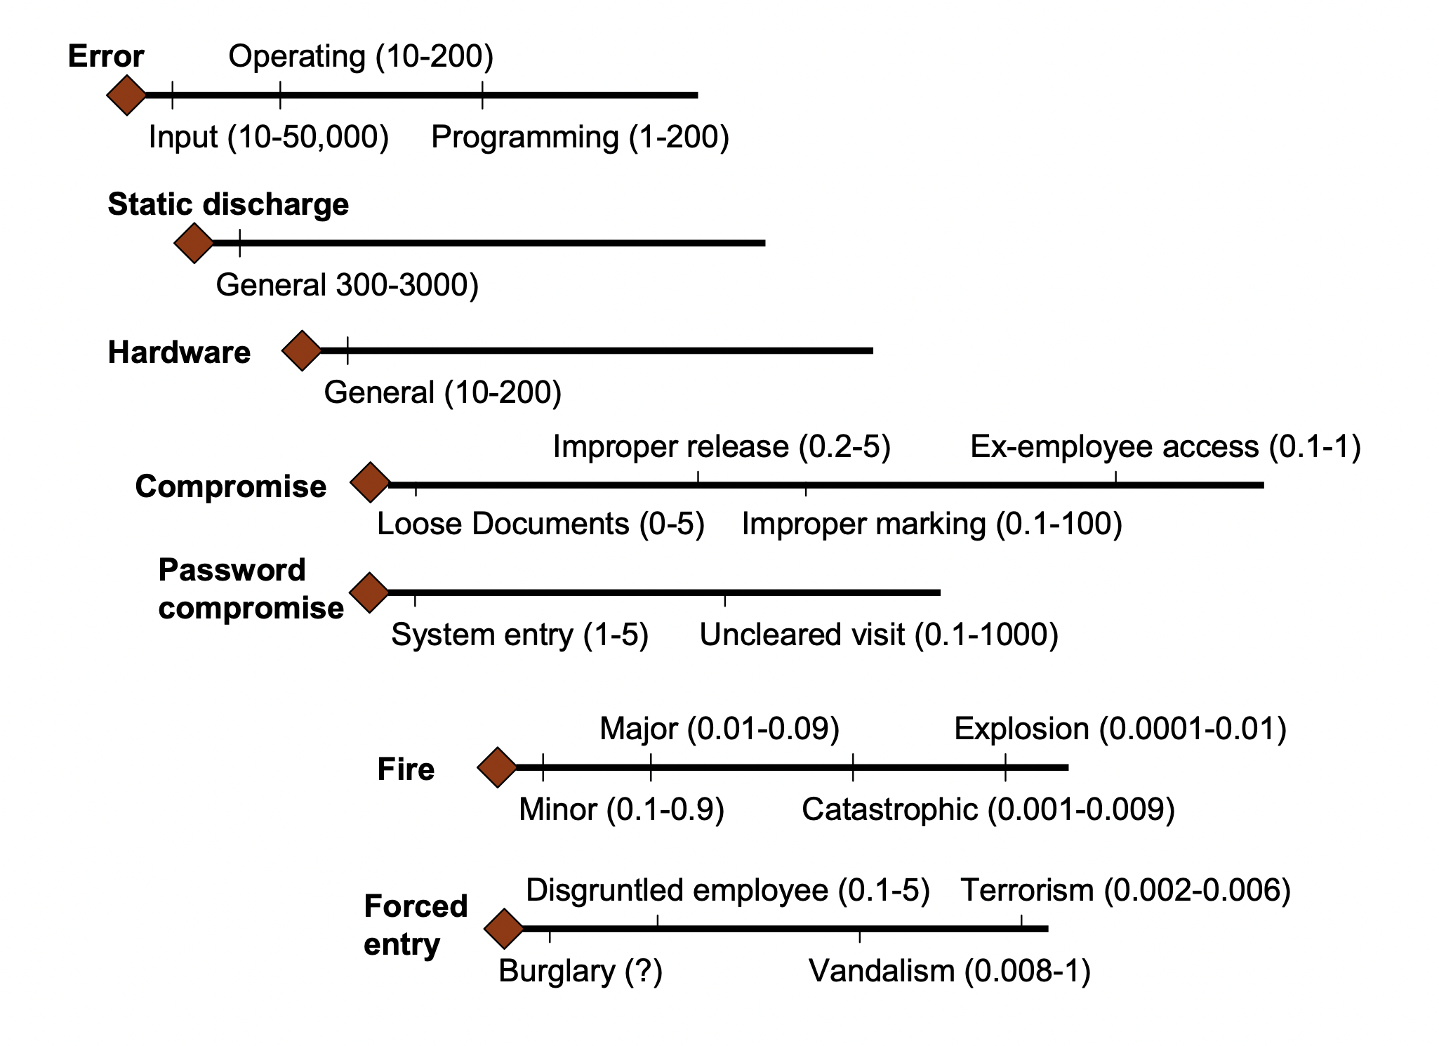
Risks, Costs and Benefits

Slide 10
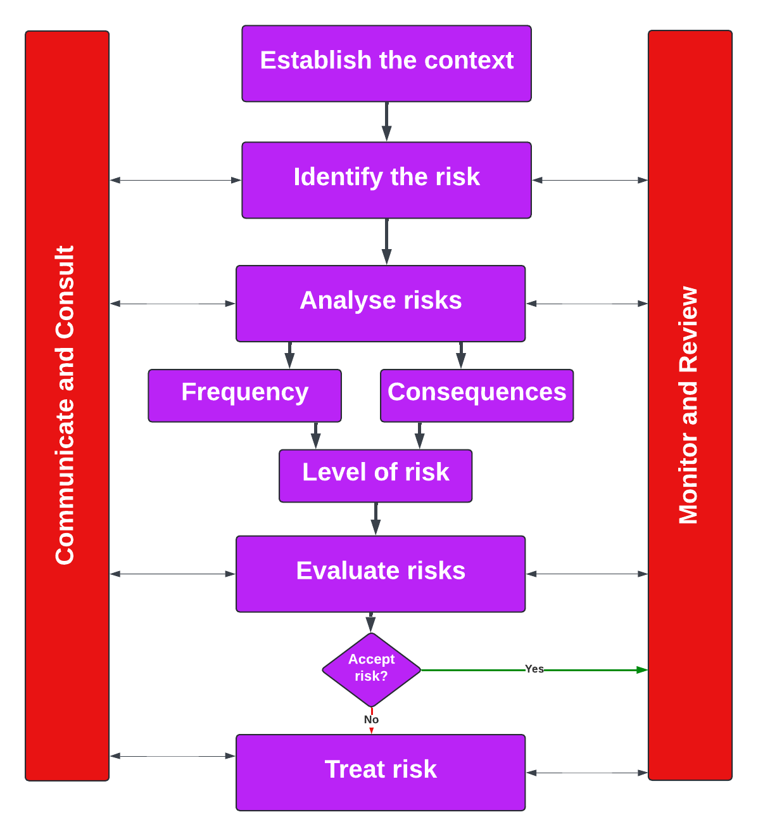
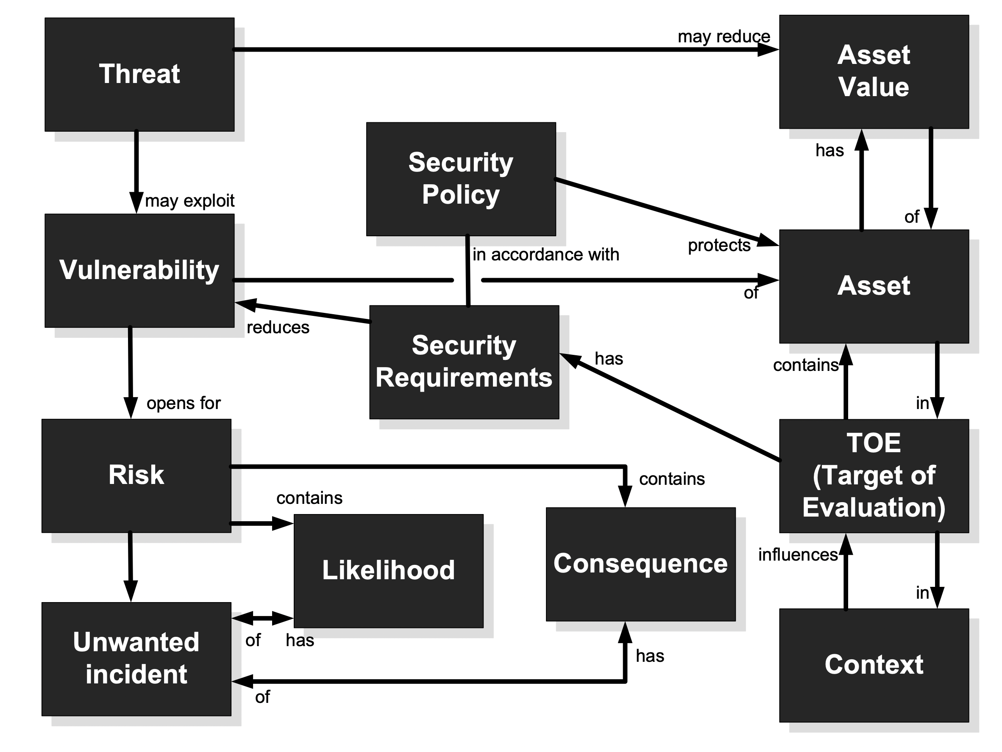
CORAS Risk Management/Ontology

Slide 11
Kill Chain Model
“From bits to information”

Slide 12
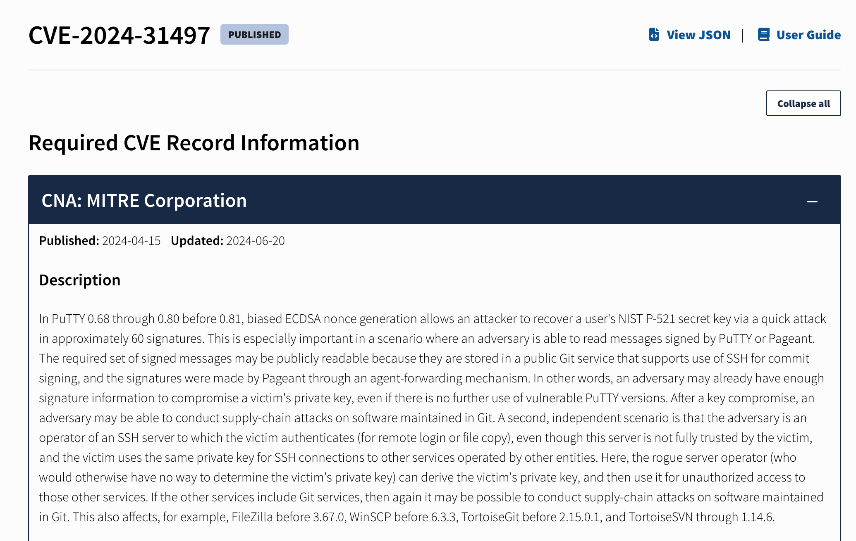
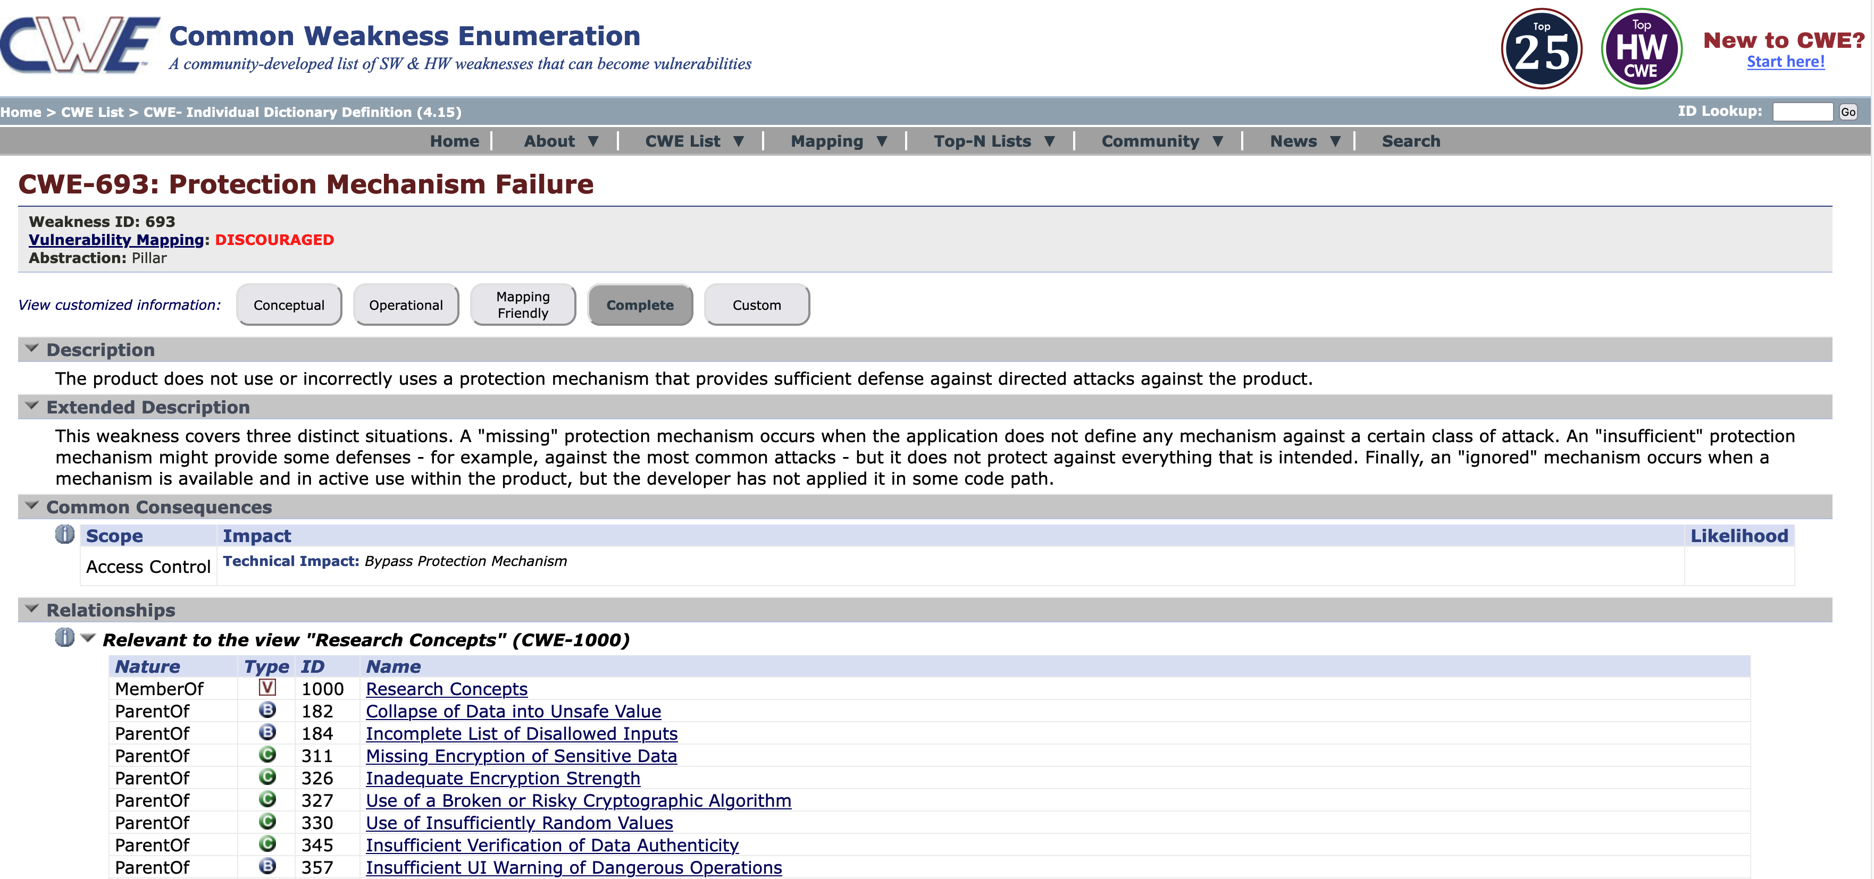
CVE Reporting

Slide 13
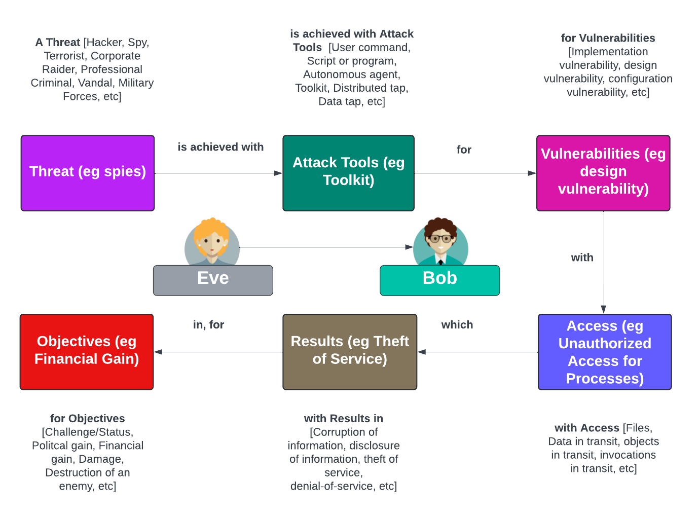
Incident Taxonomy

Slide 14
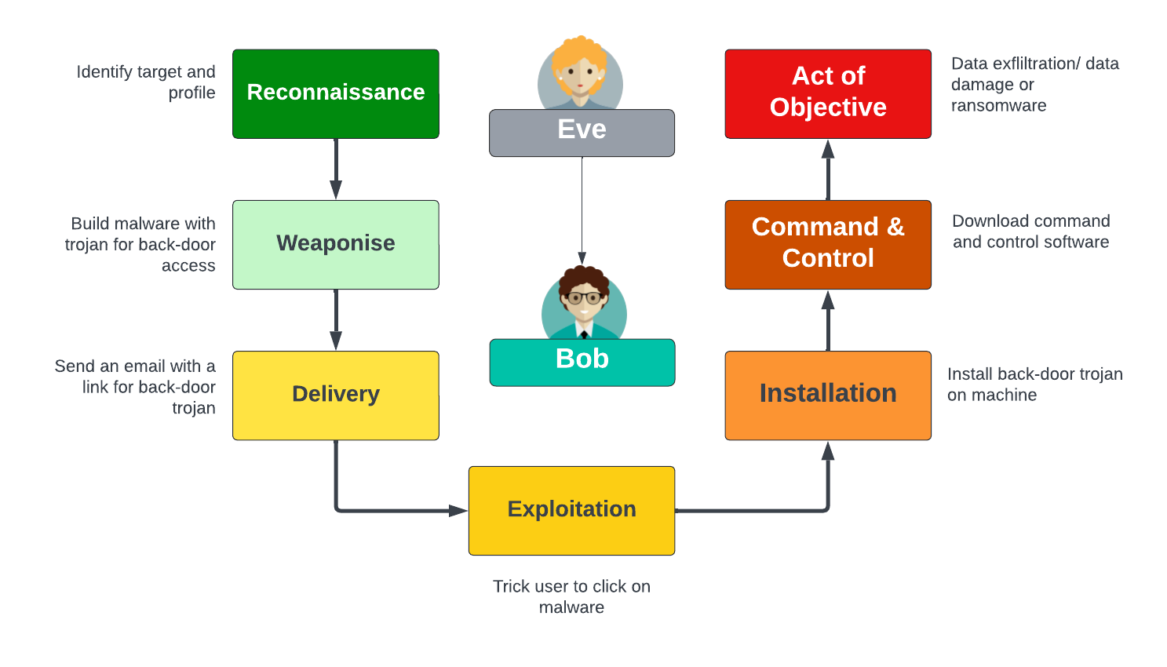
Kill Chain Model

Slide 15
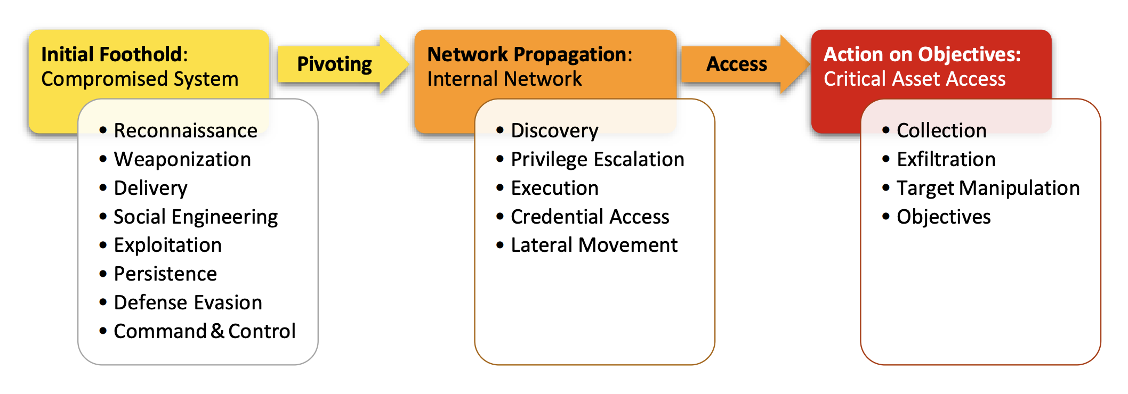
Unified Kill Chain Phases
Pols, P., & van den Berg, J. (2017). The unified kill chain. CSA Thesis, Hague, 1-104.

Slide 16
MITRE ATT&CK
“From bits to information”

Slide 17
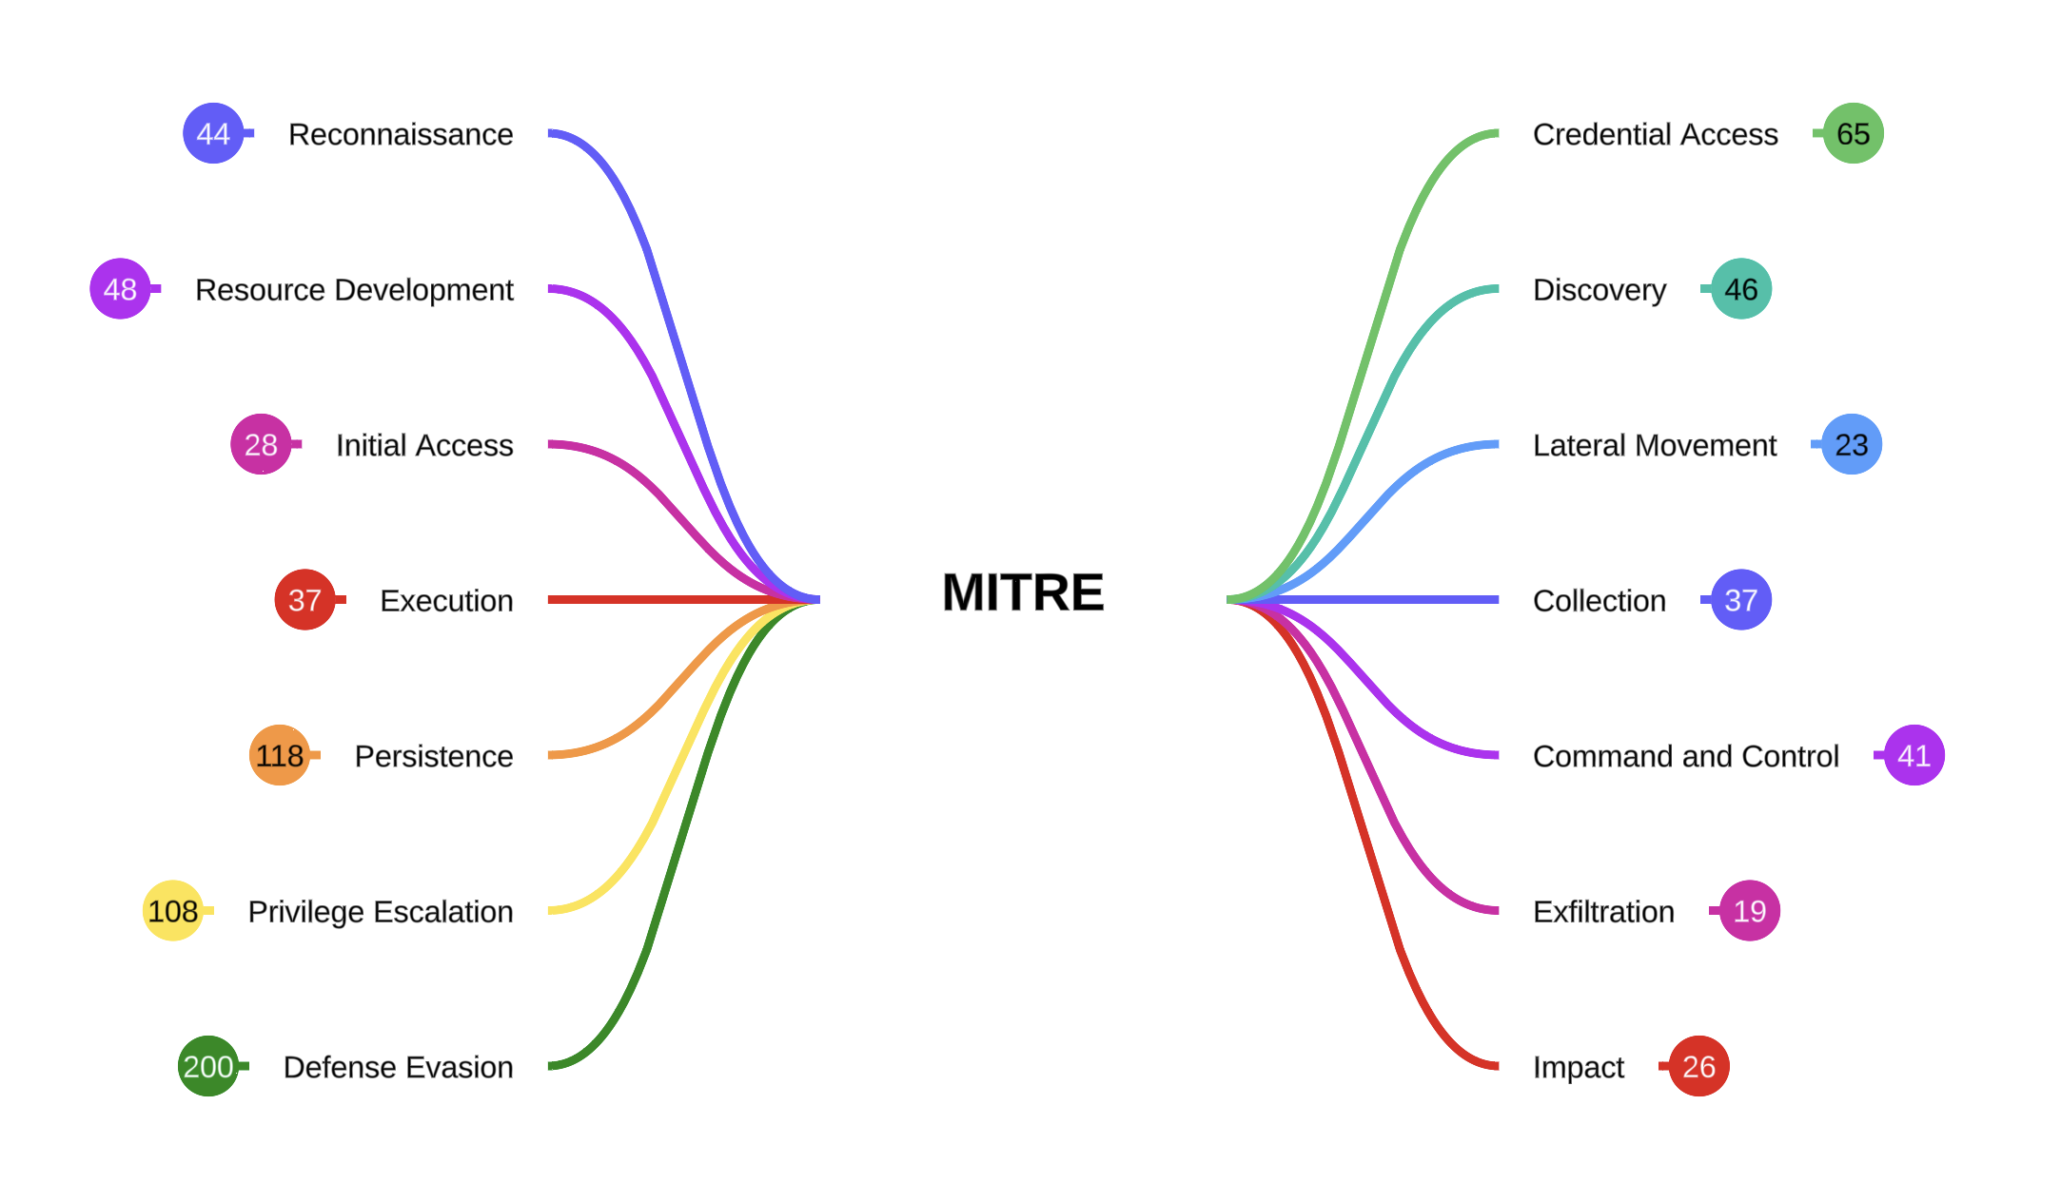
MITRE ATT&CK (Enterprise)

Slide 18
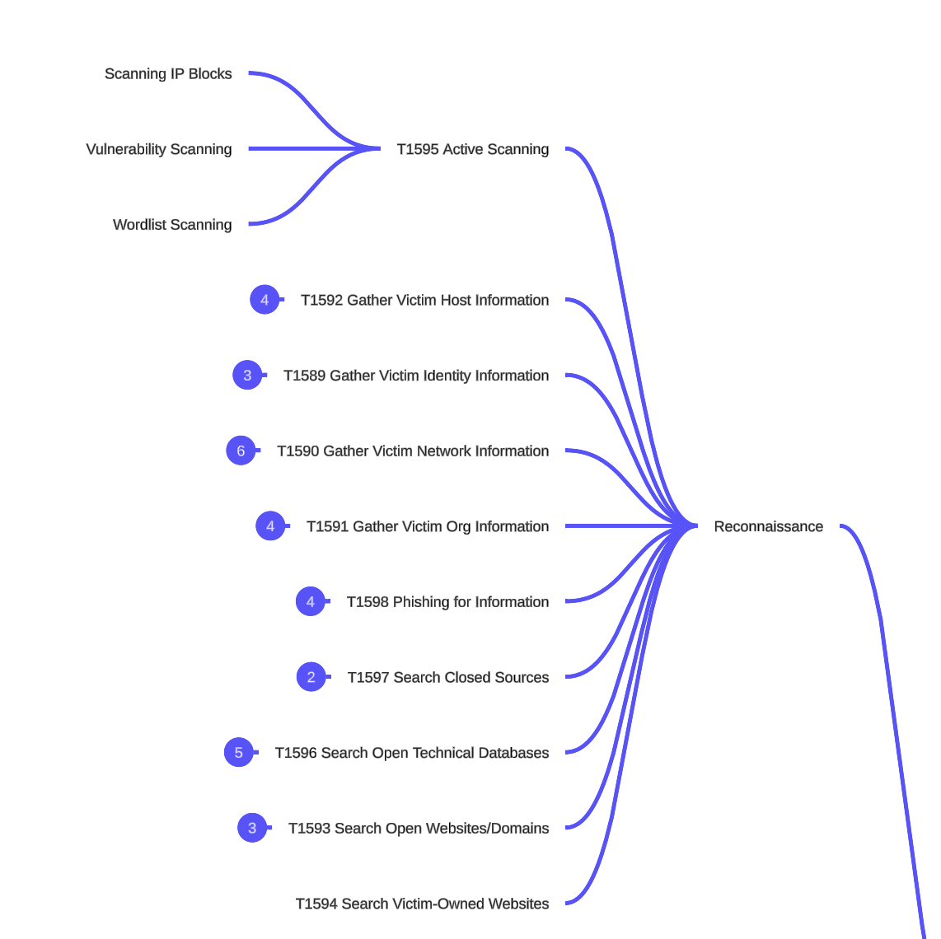
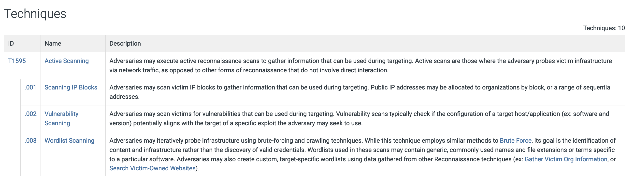
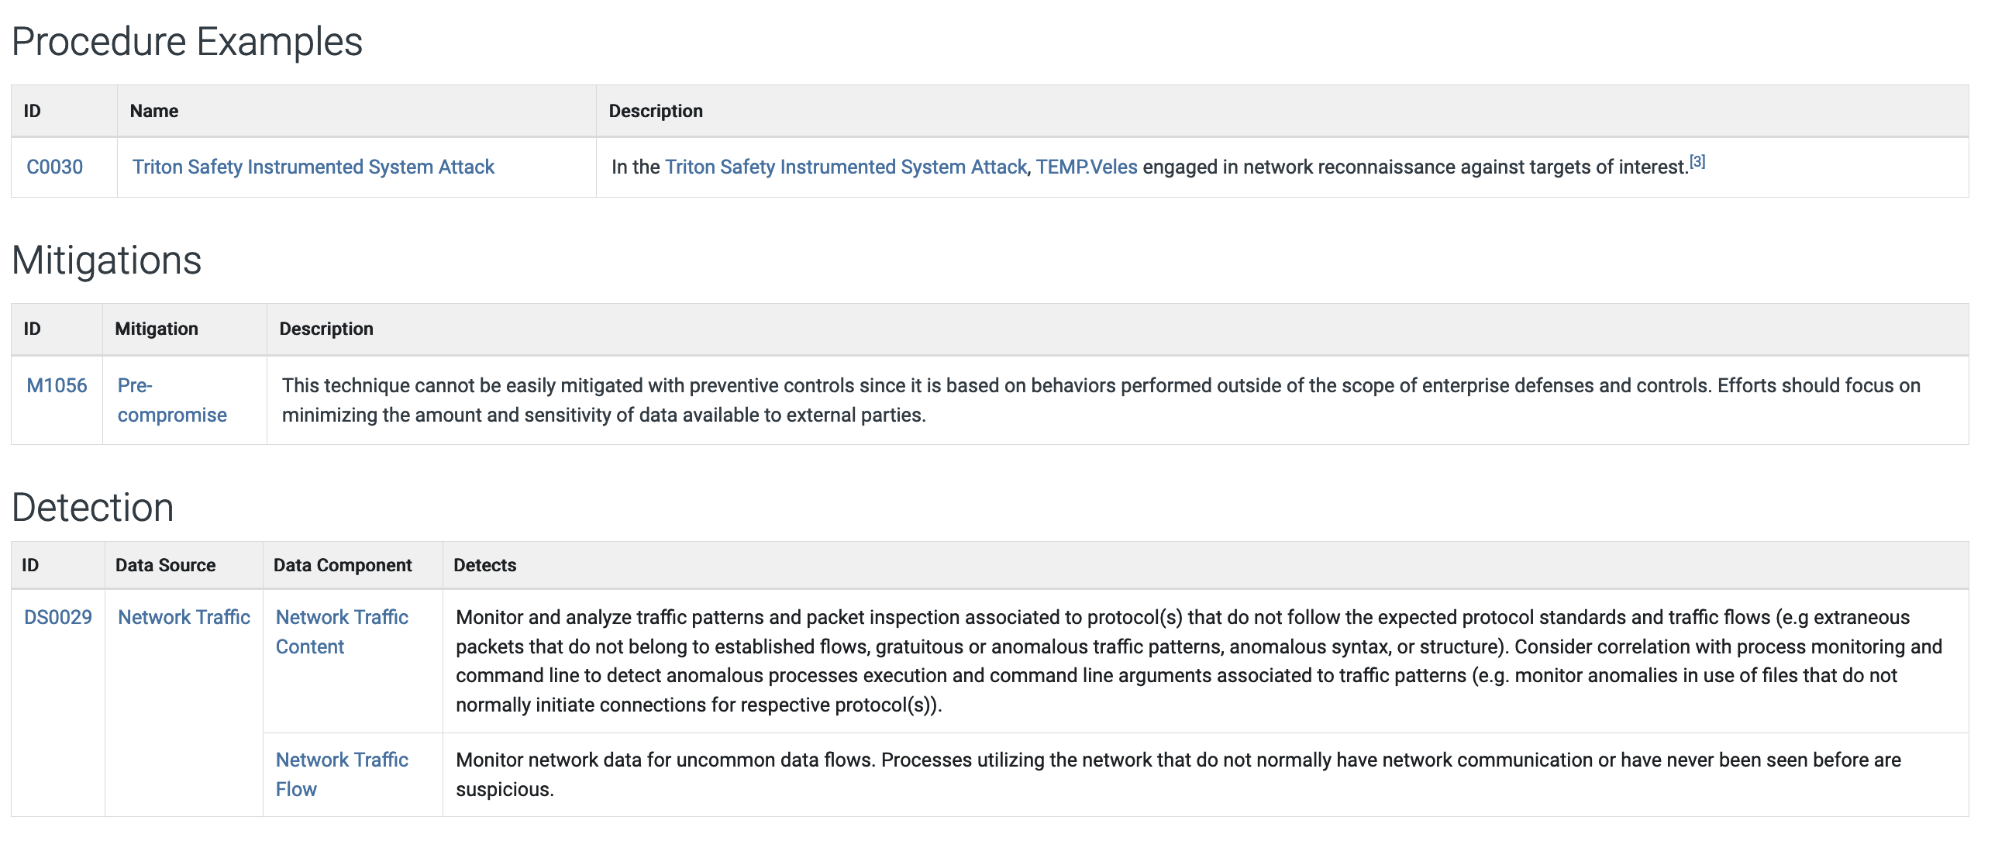
MITRE ATT&CK (Enterprise)

Slide 19
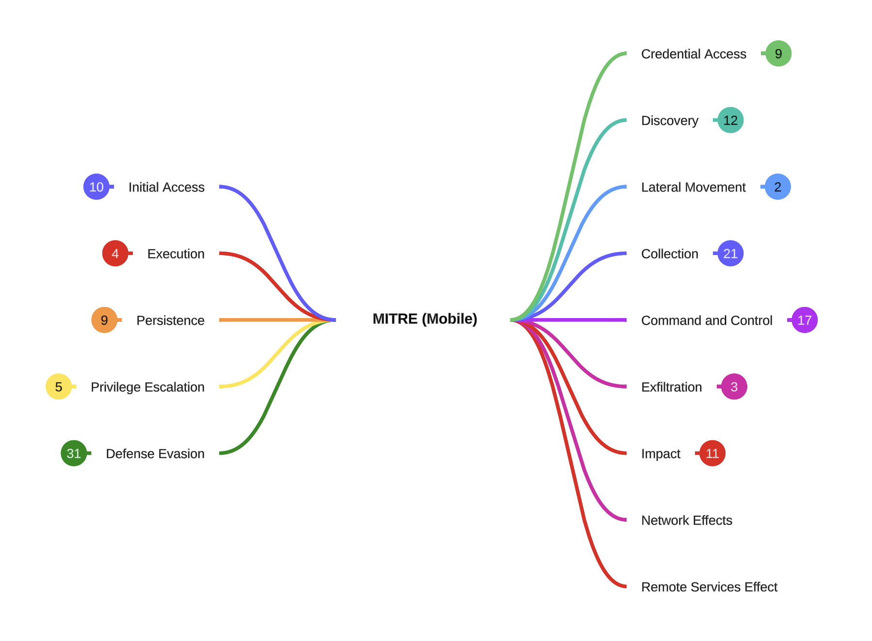
MITRE ATT&CK (Mobile)

Slide 20
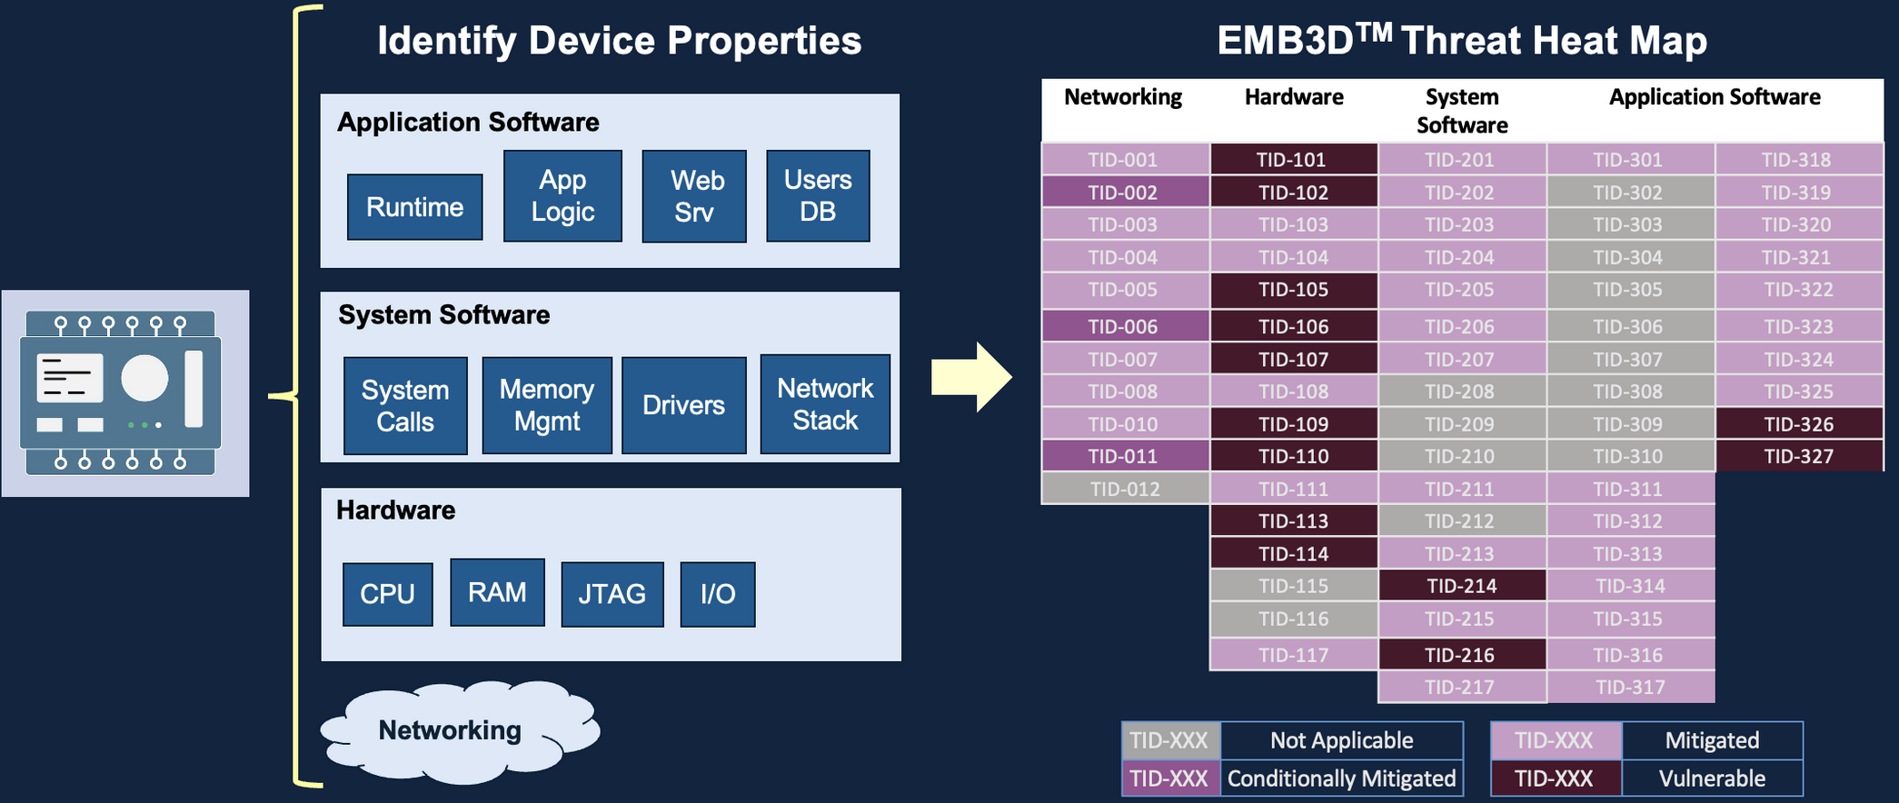
MITRE EMB3D (Embedded Devices)

Slide 21
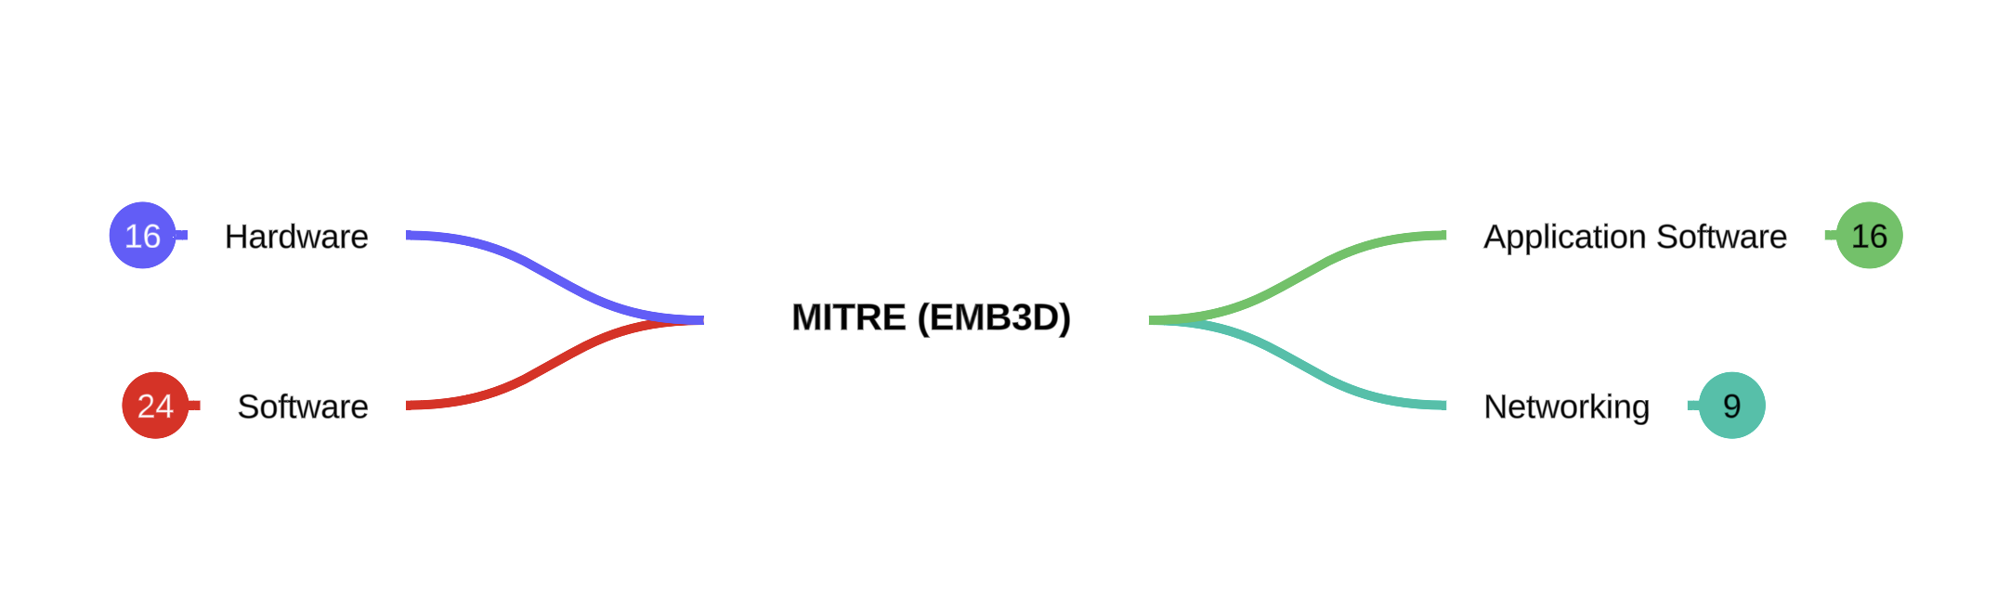
MITRE EMB3D (Embedded Devices)

Slide 22
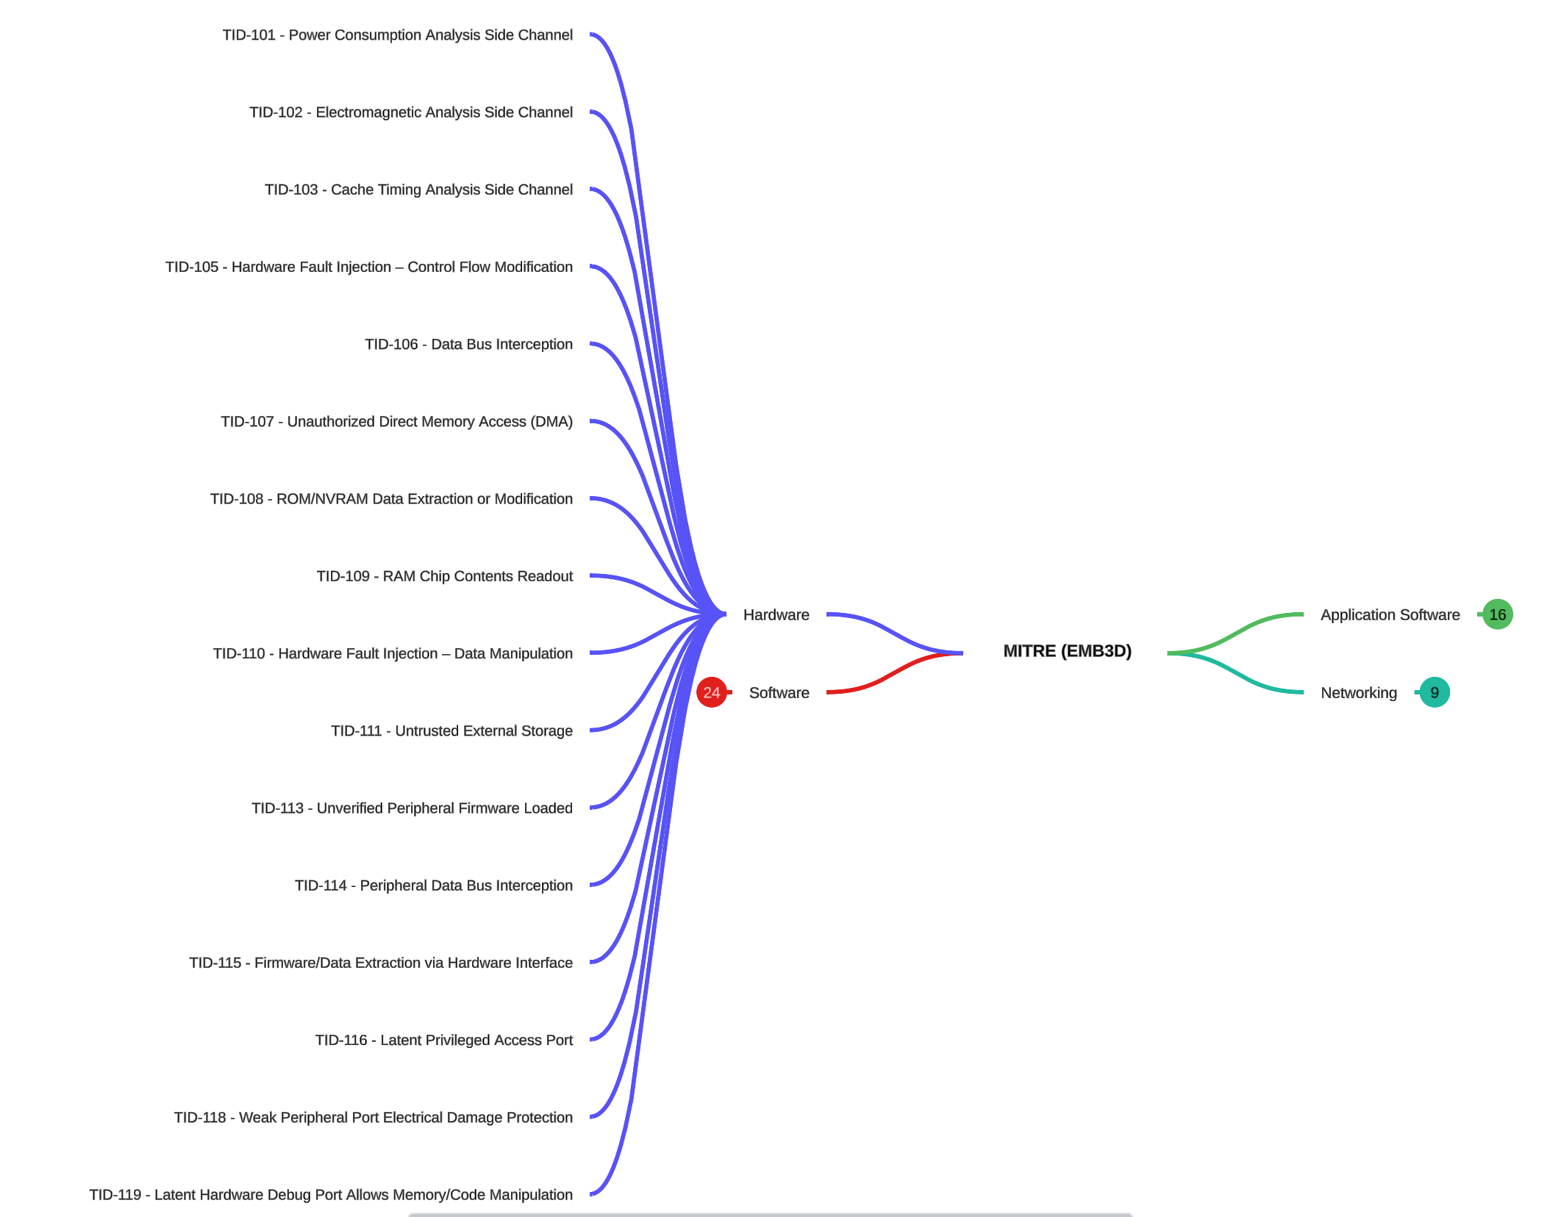
MITRE EMB3D (Embedded Devices)

Slide 23
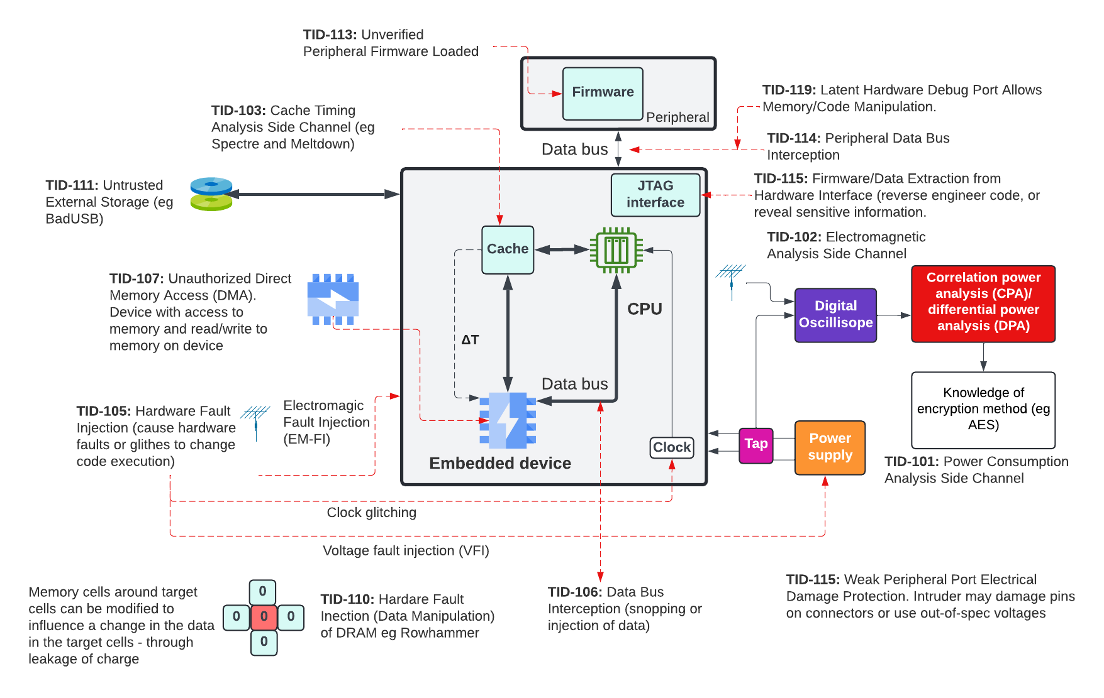
MITRE EMB3D (Embedded Devices)

Slide 24
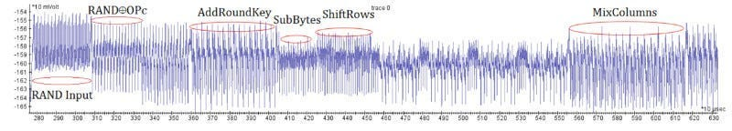
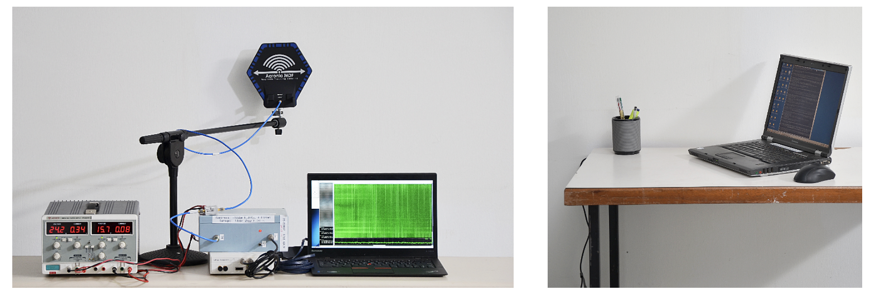
MITRE EMB3D (Embedded Devices) – Symmetric Key Crack

Slide 25
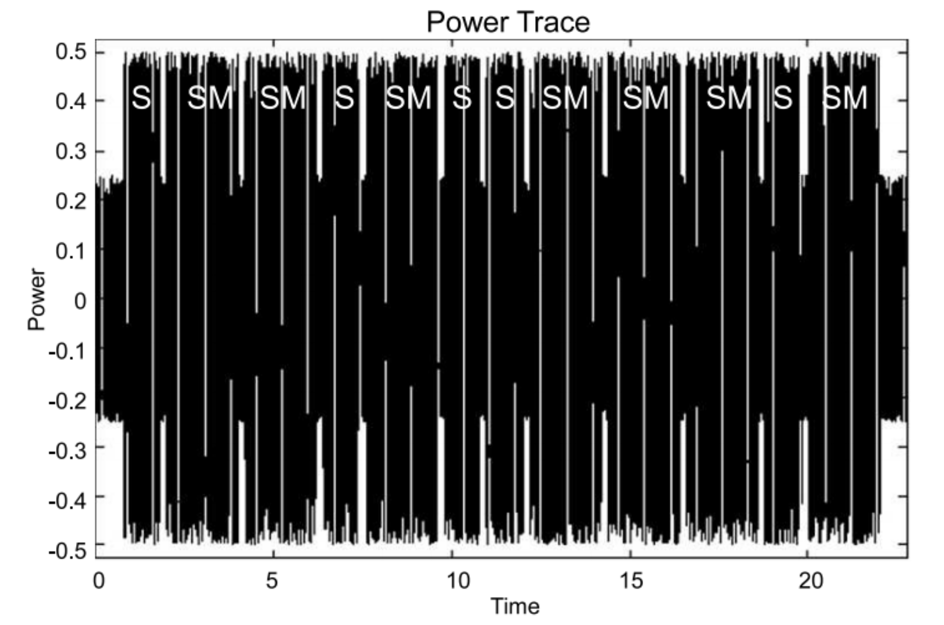
MITRE EMB3D (Embedded Devices) – RSA Crack

Slide 26
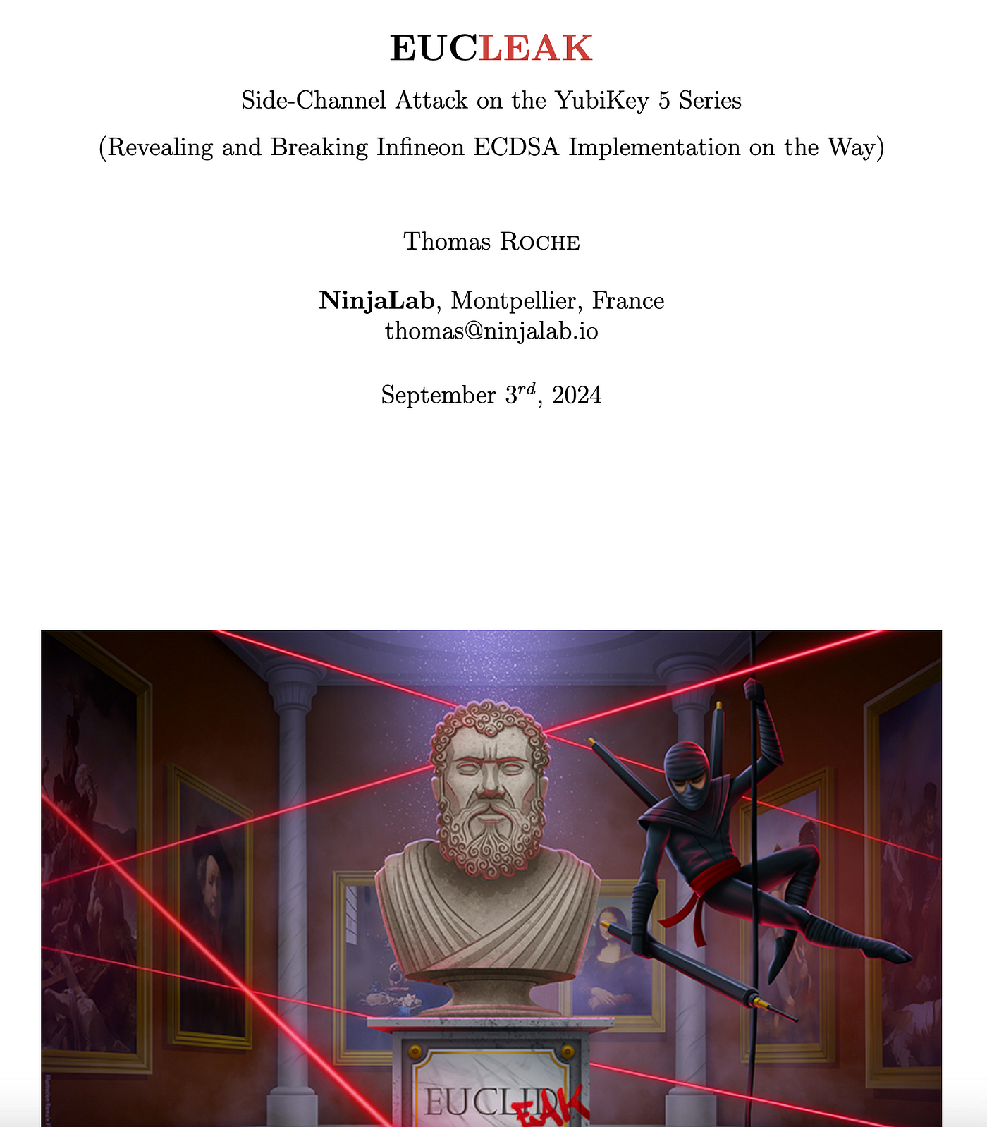
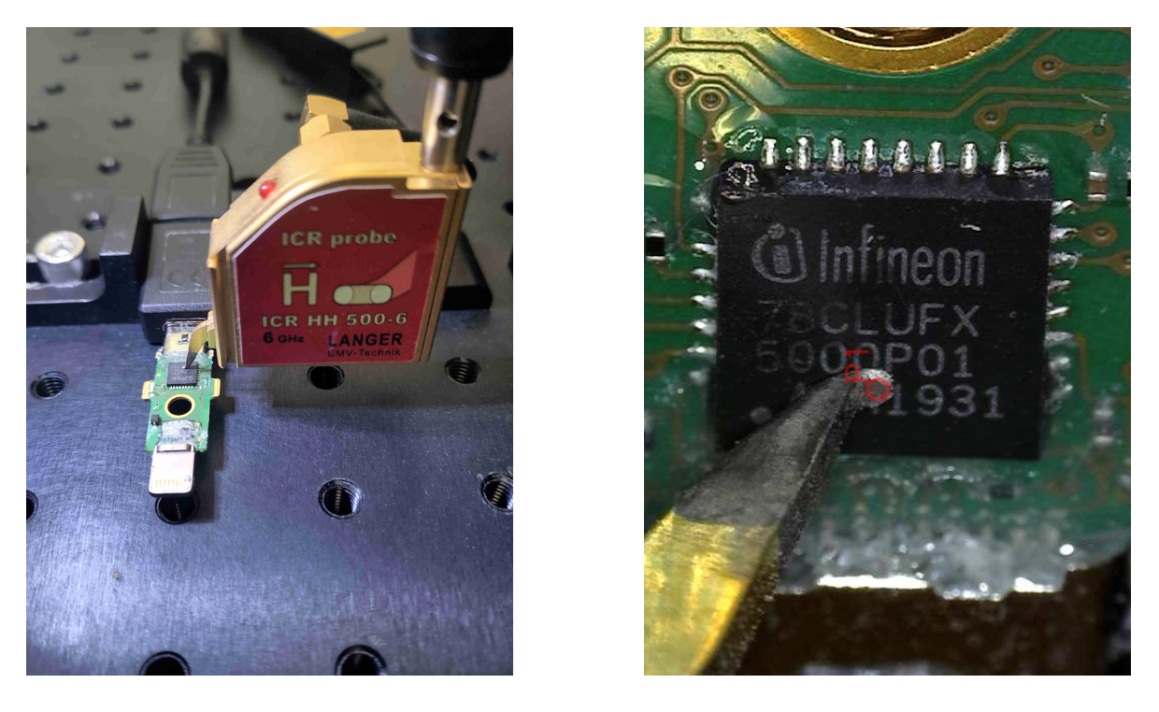
MITRE EMB3D (Embedded Devices)

Slide 27
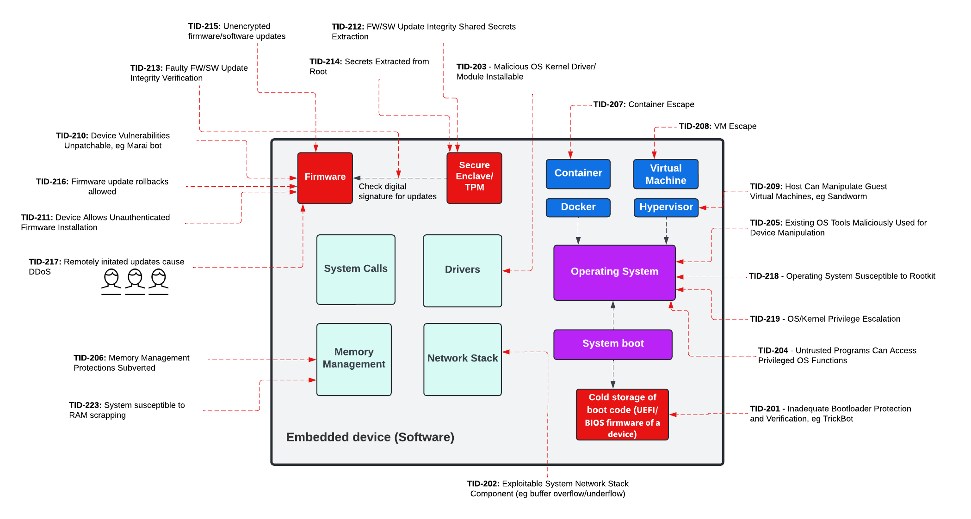
MITRE EMB3D (Embedded Devices)

Slide 28
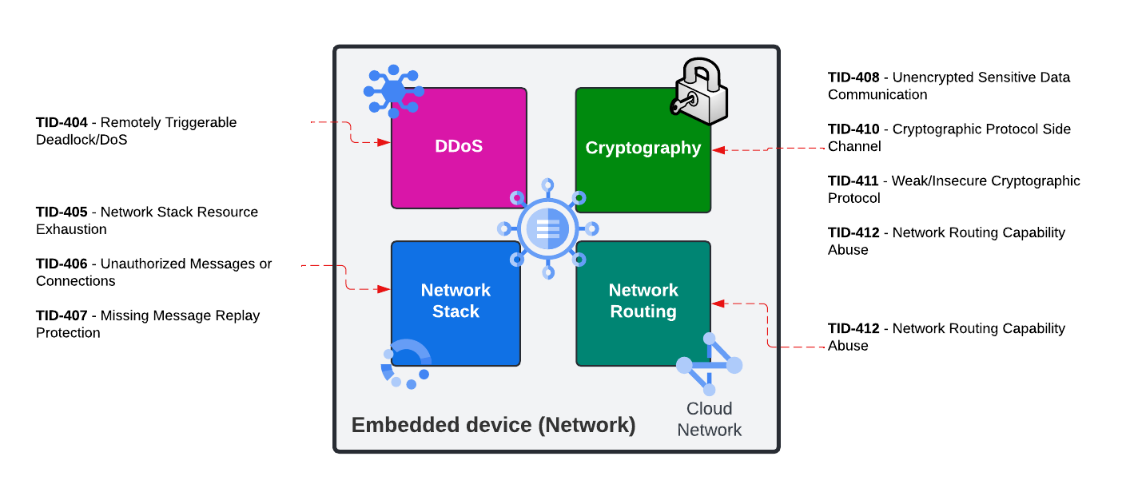
MITRE EMB3D (Embedded Devices)

Slide 29
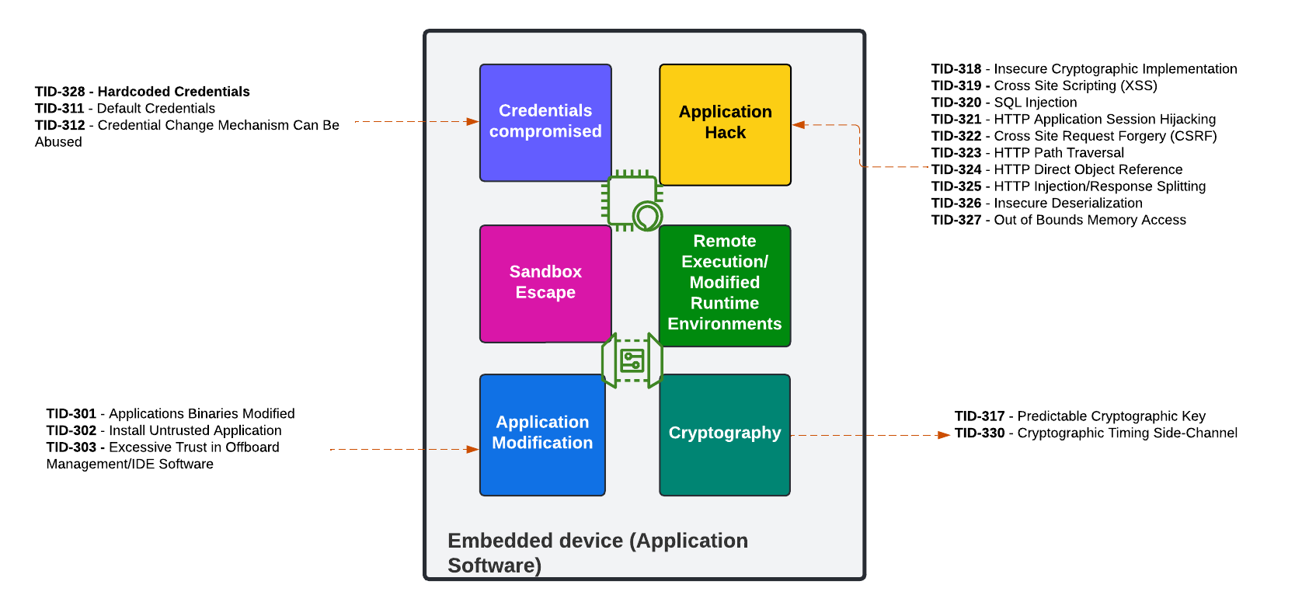
MITRE EMB3D (Embedded Devices)

Slide 30
Basic Terms
“From bits to information”

Slide 31
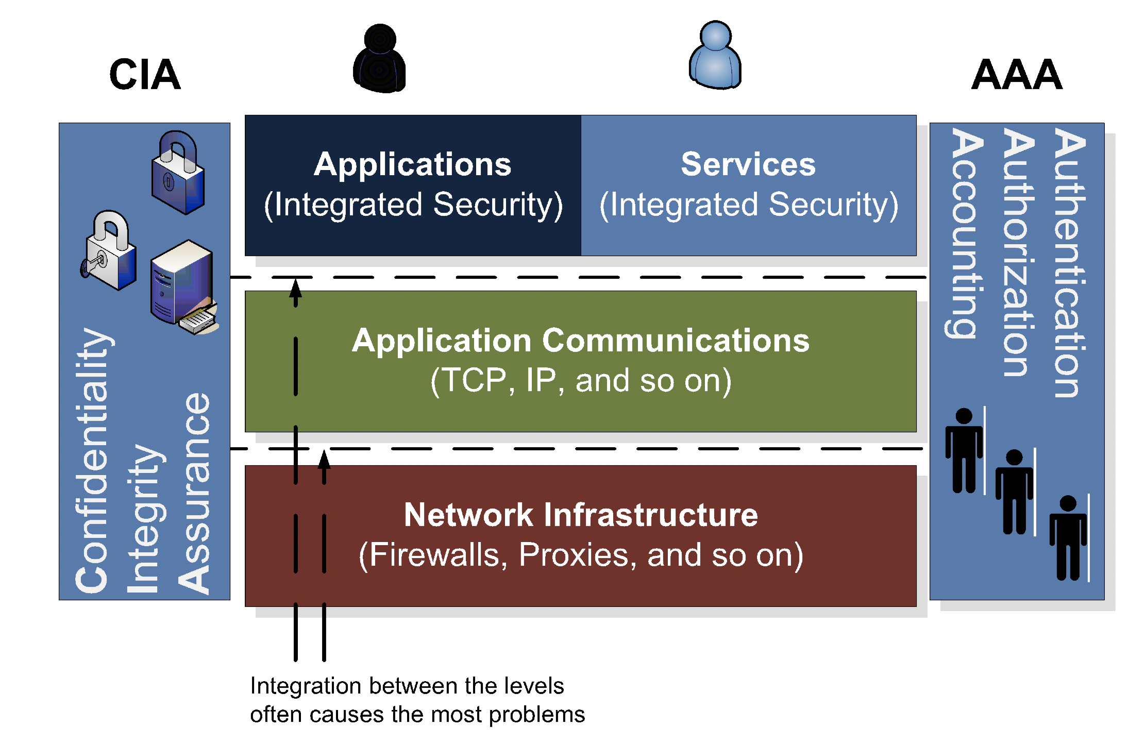
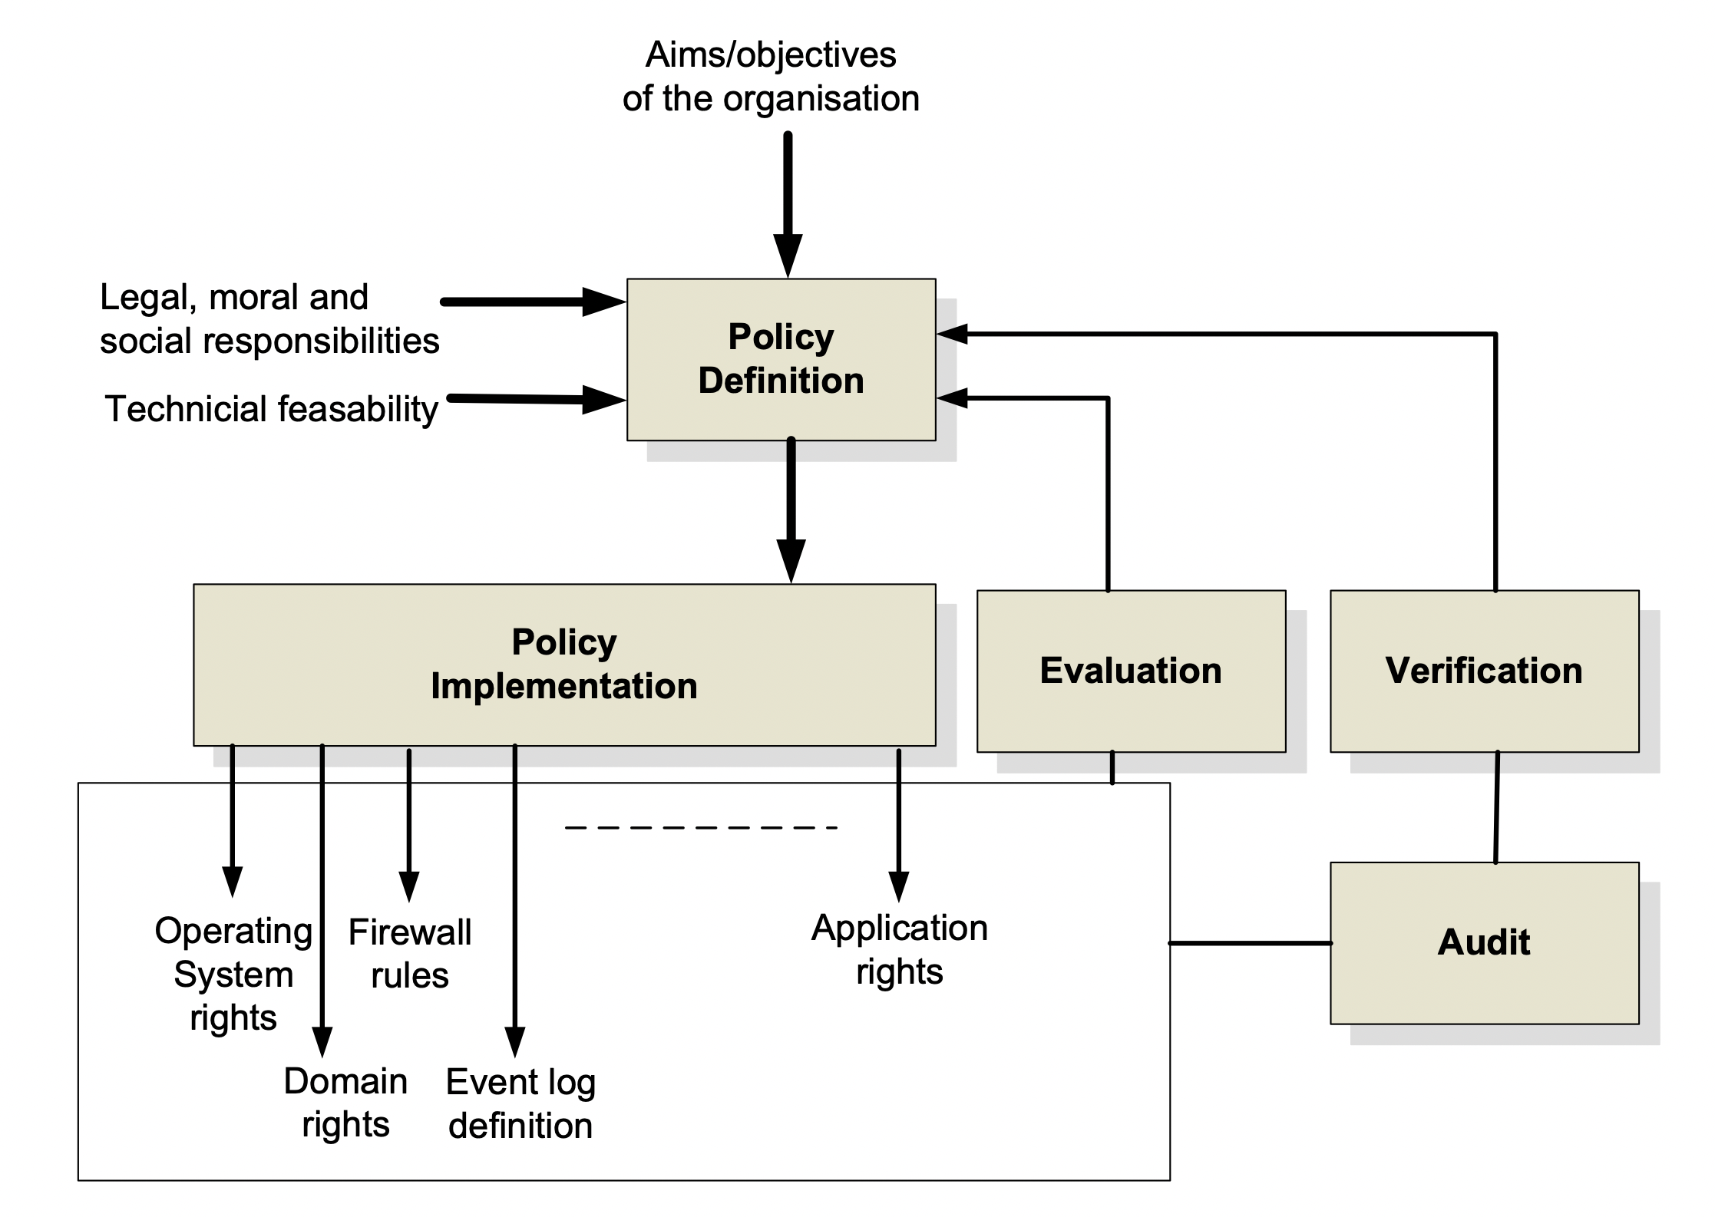
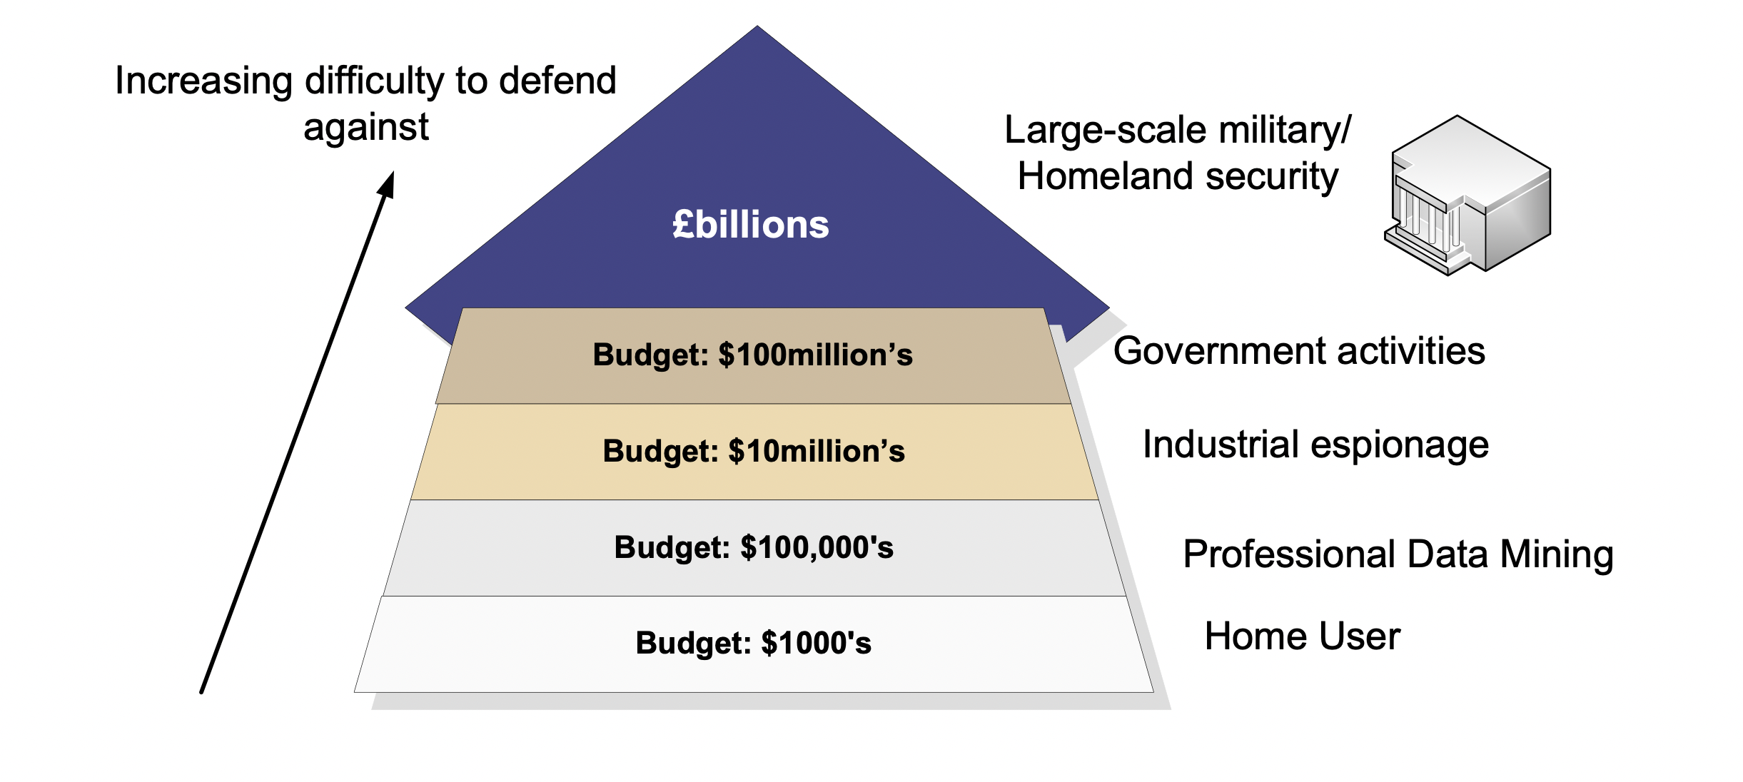
Policies
Deter. This is where the system is designed and implemented in order to initially deter intruders from attacking the system in the first place.
Log. This is a key element in modern systems which requires some form of logging system. It is important that the data that is logged does not breach any civil liberties, and is in a form which can be used to enhance the future security of the system.
Detect. This is where detection agents are placed within the network to detect intrusions, and has methods of tracing the events that occurred in an intrusion, so that it can be used either in a forensic computing investigation, and/or to overcome a future intrusion. Organisations often have many reasons for detecting network traffic.
Protect. This is where policies are created which protect systems, users and data against attack, and in reducing this potential damage. A key element of this is to protect them against accidental damage, as accidental damage is often more prevalent than non-accidental damage.
React. This is where a policy is defined which reacts to intrusions, and defines ways to overcome them in the future. Often organisations do not have formal policies for this type of activity, and often rely on ad-hoc arrangements, where the method of reacting to a security breach is created after the event.
Recover. This is where policies are defined to overcome any system damage, whether it is actual physical damage, the abuse of users; or the damage to data.
Audit/verify. It is important that the security policy allows for auditing and for the verification that it achieves its requirements.

Slide 32
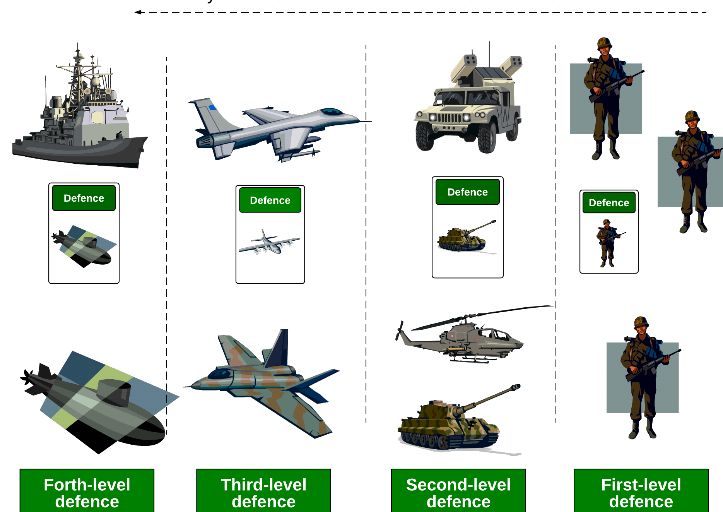
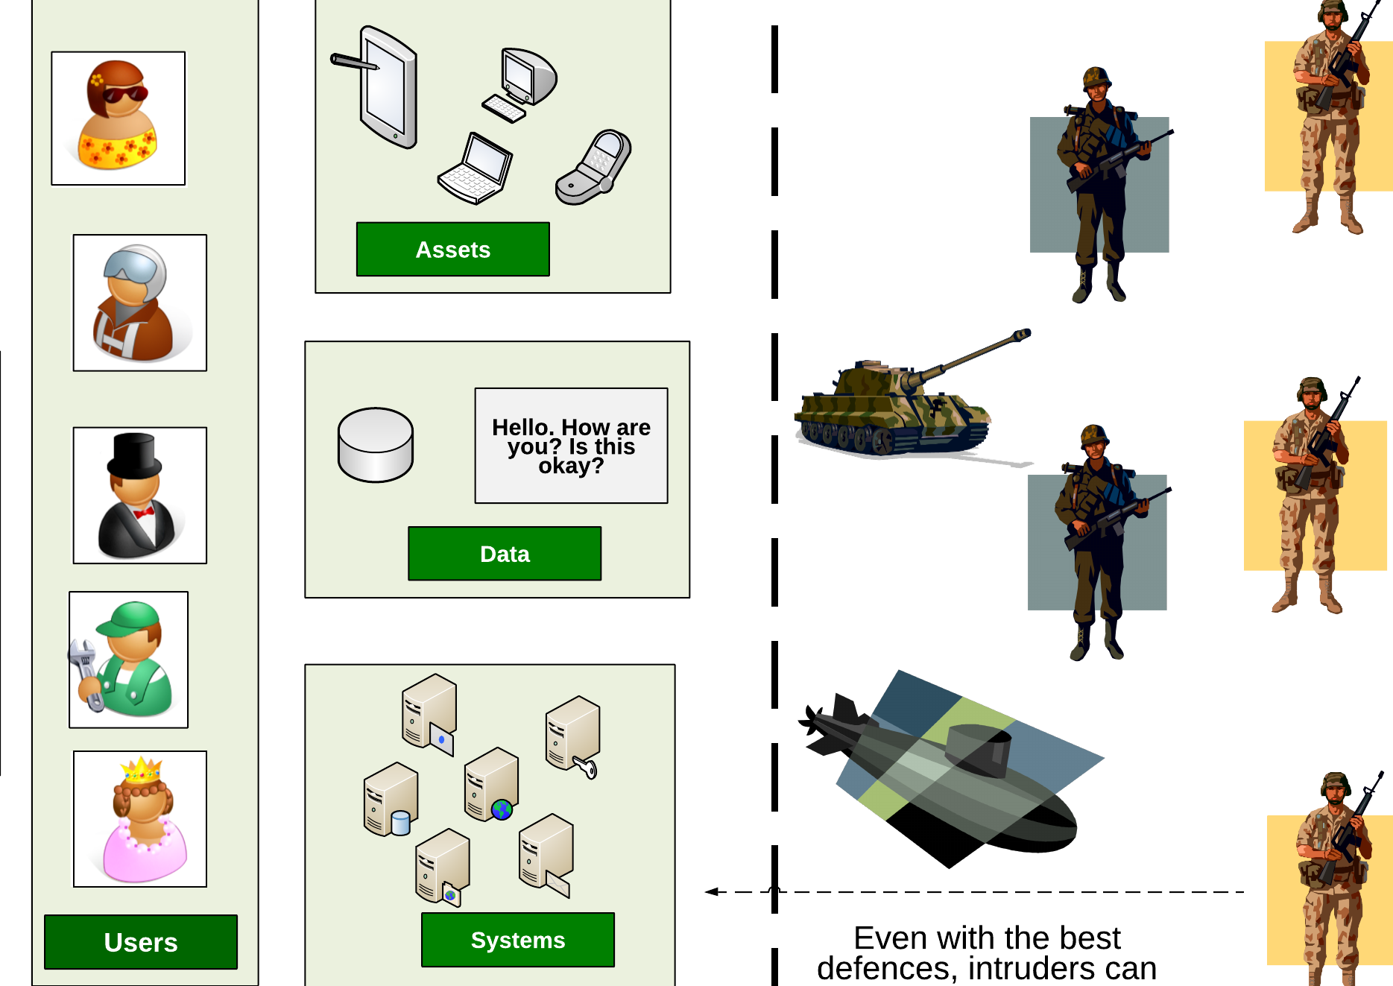
Defence in depth

Slide 33
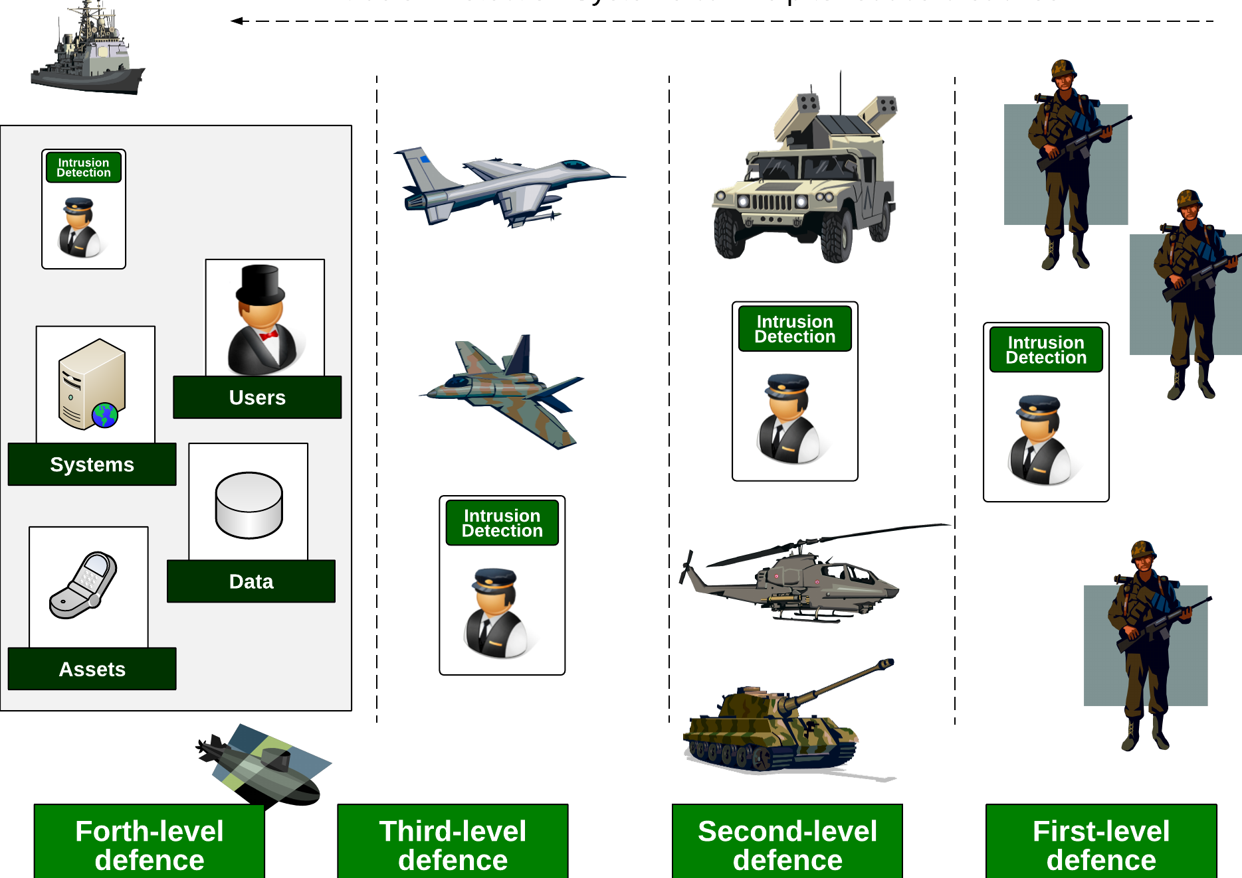
Intrusion Detection Systems (IDS)

Slide 34
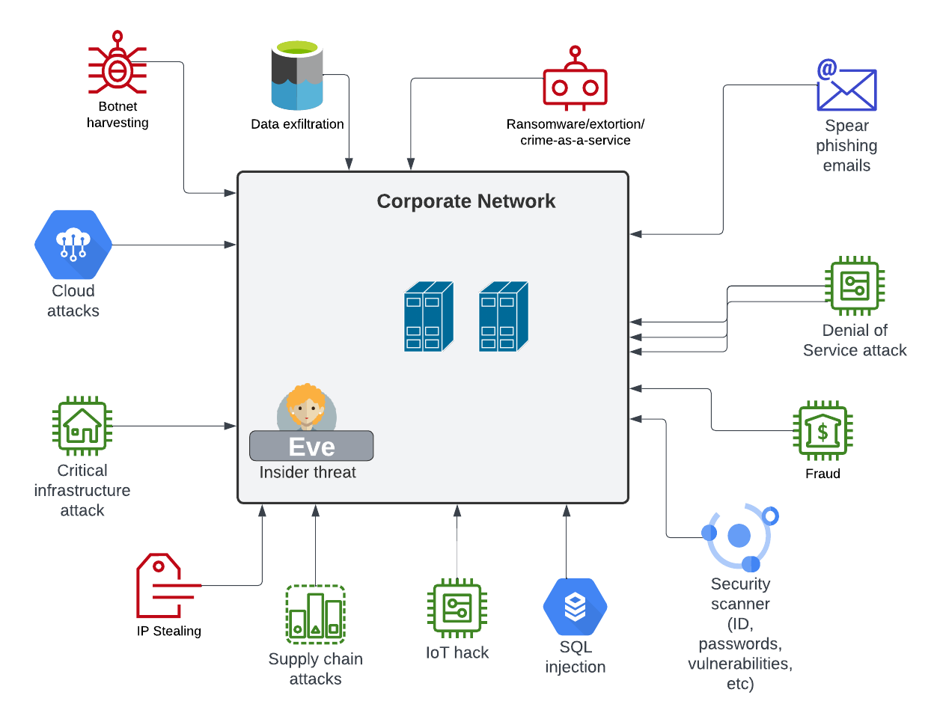
Threats

Slide 35
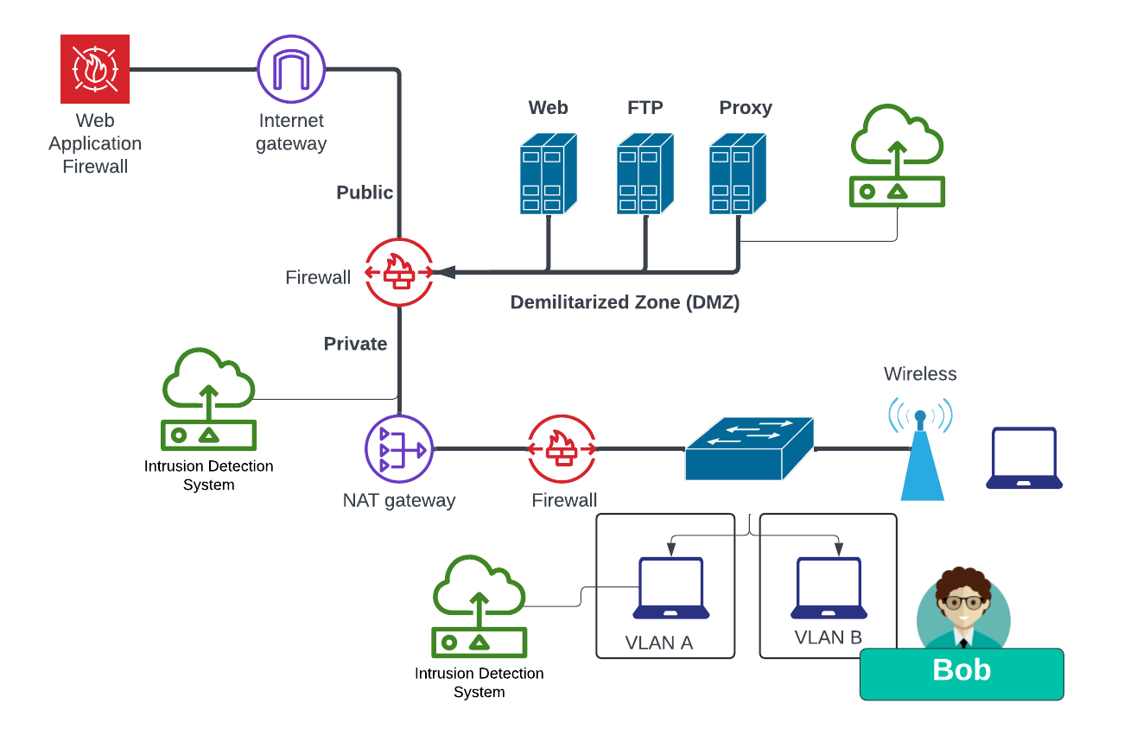
Defence in depth

Slide 36
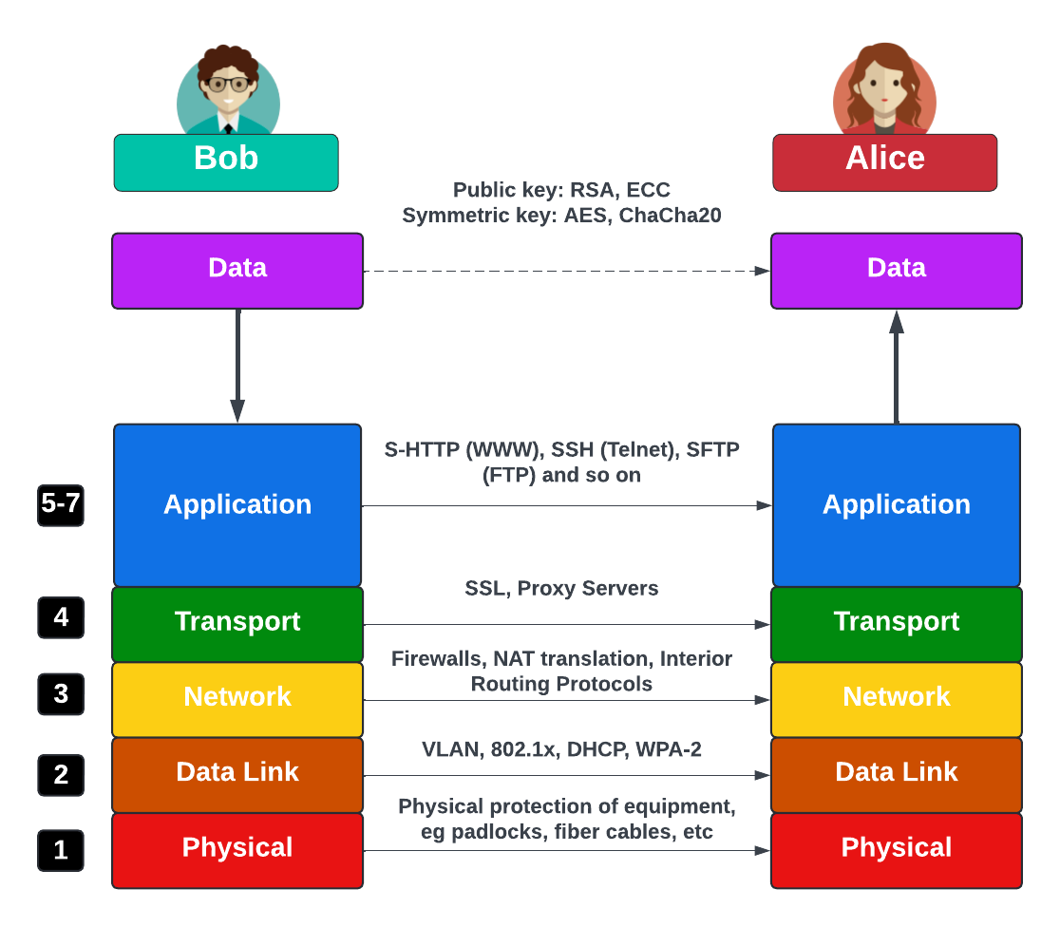
OSI 7-Layered Model

Slide 37
Basics of Cryptography
“From bits to information”

Slide 38
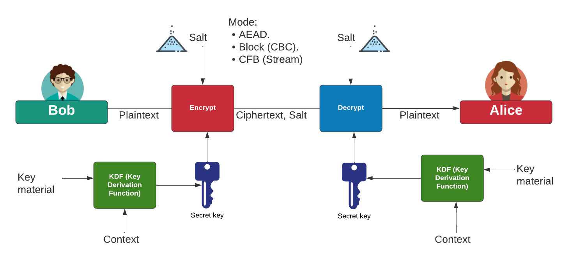
Symmetric Key Encryption

Slide 39
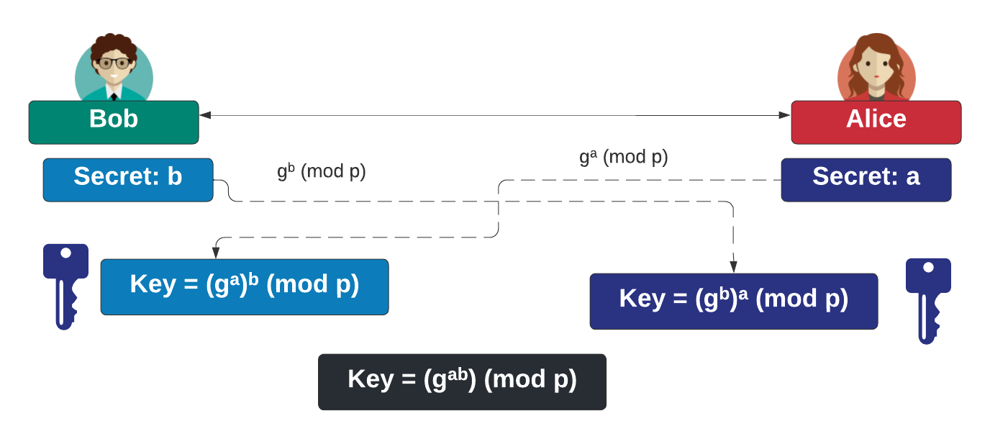
Key Exchange

Slide 40
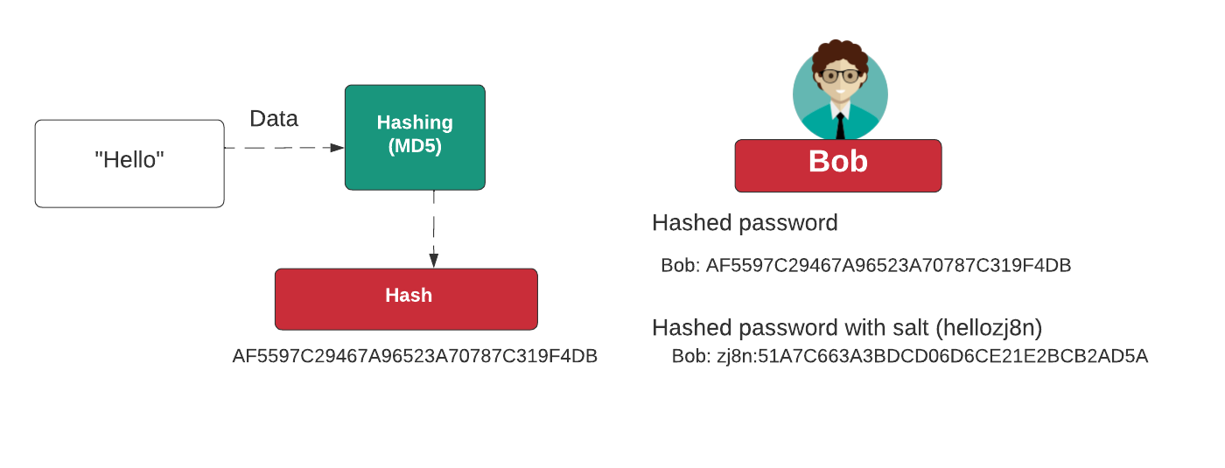
Hashing

Slide 41
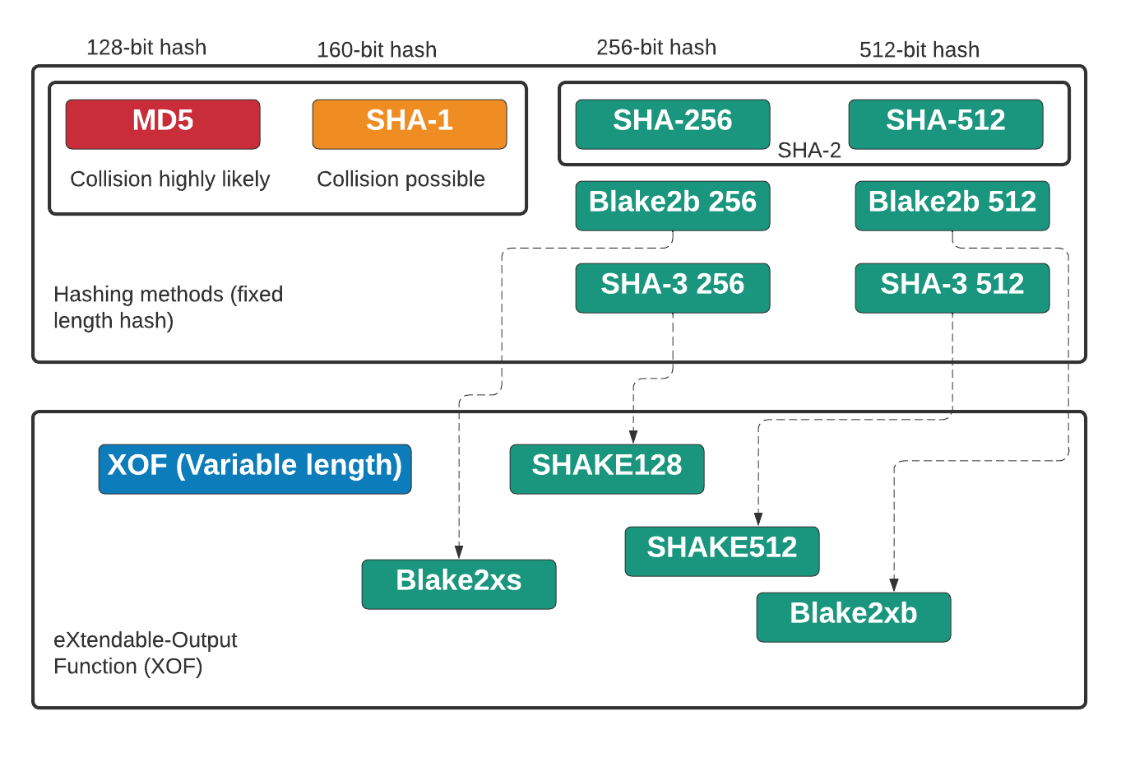
Hashing

Slide 42
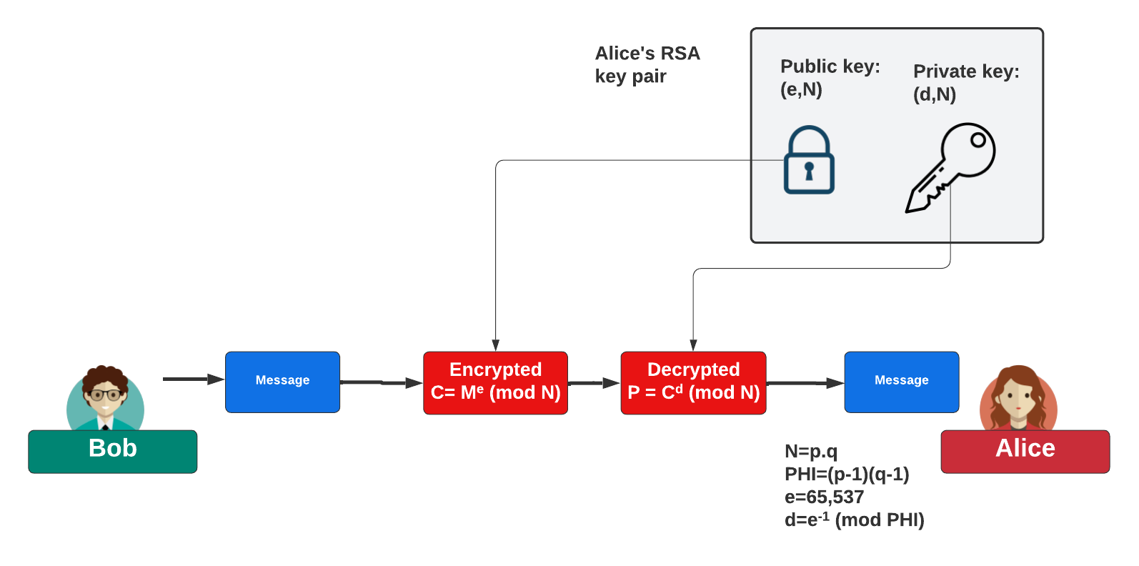
Public Key Encryption

Slide 43
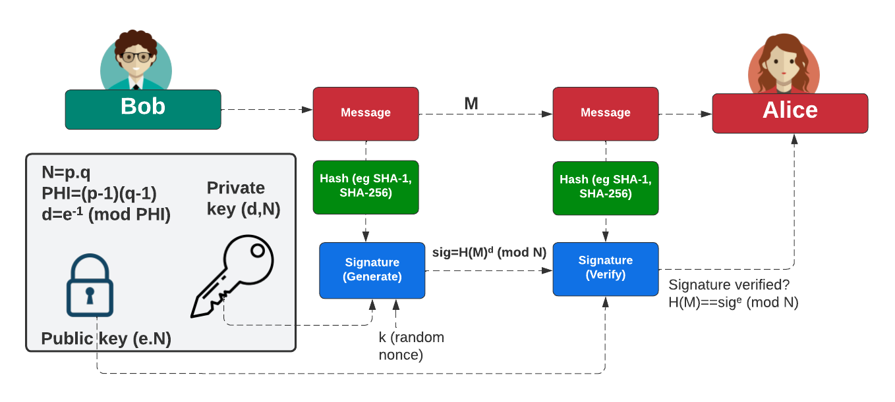
Public Key (Digital Signing)

Slide 44
Outline of Secure Architectures
“From bits to information”

Slide 45
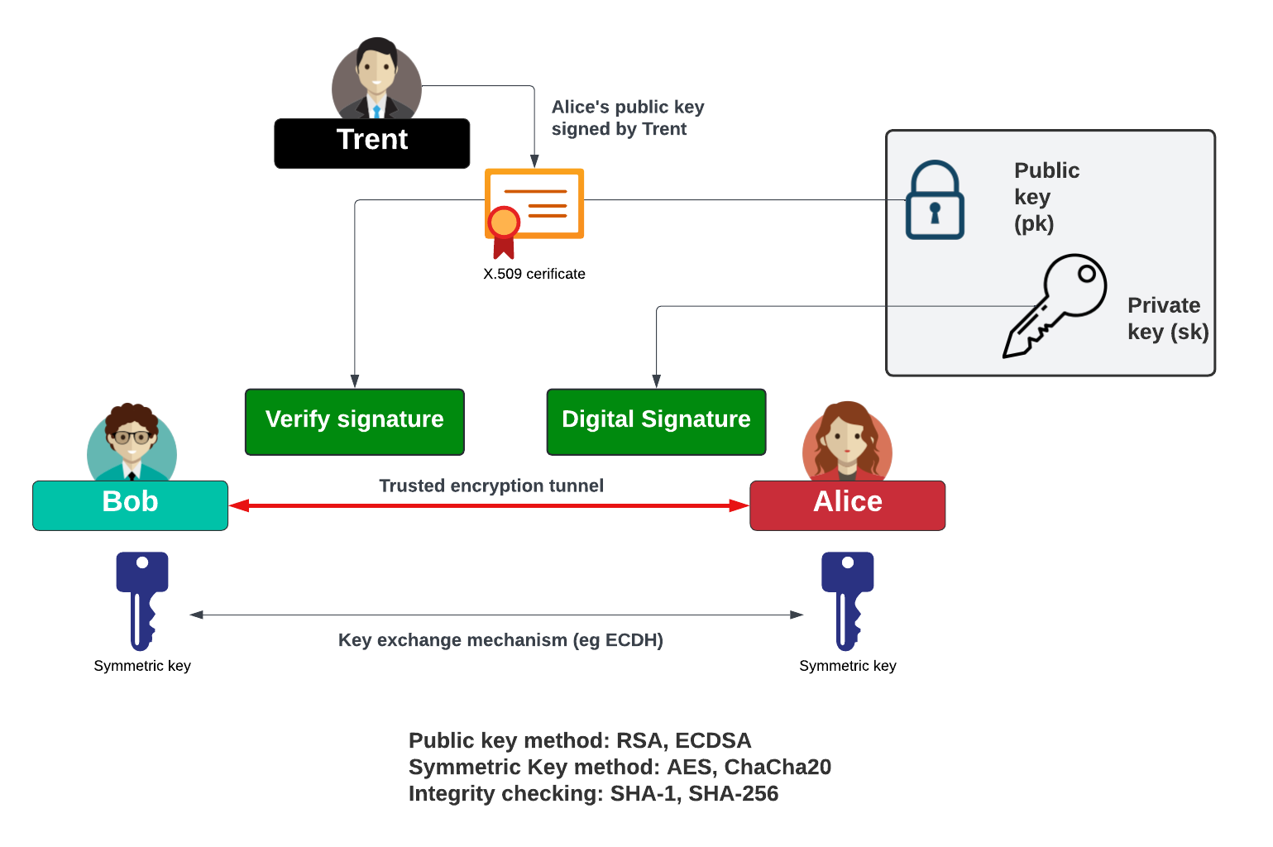
Trust, Privacy and Integrity

Slide 46
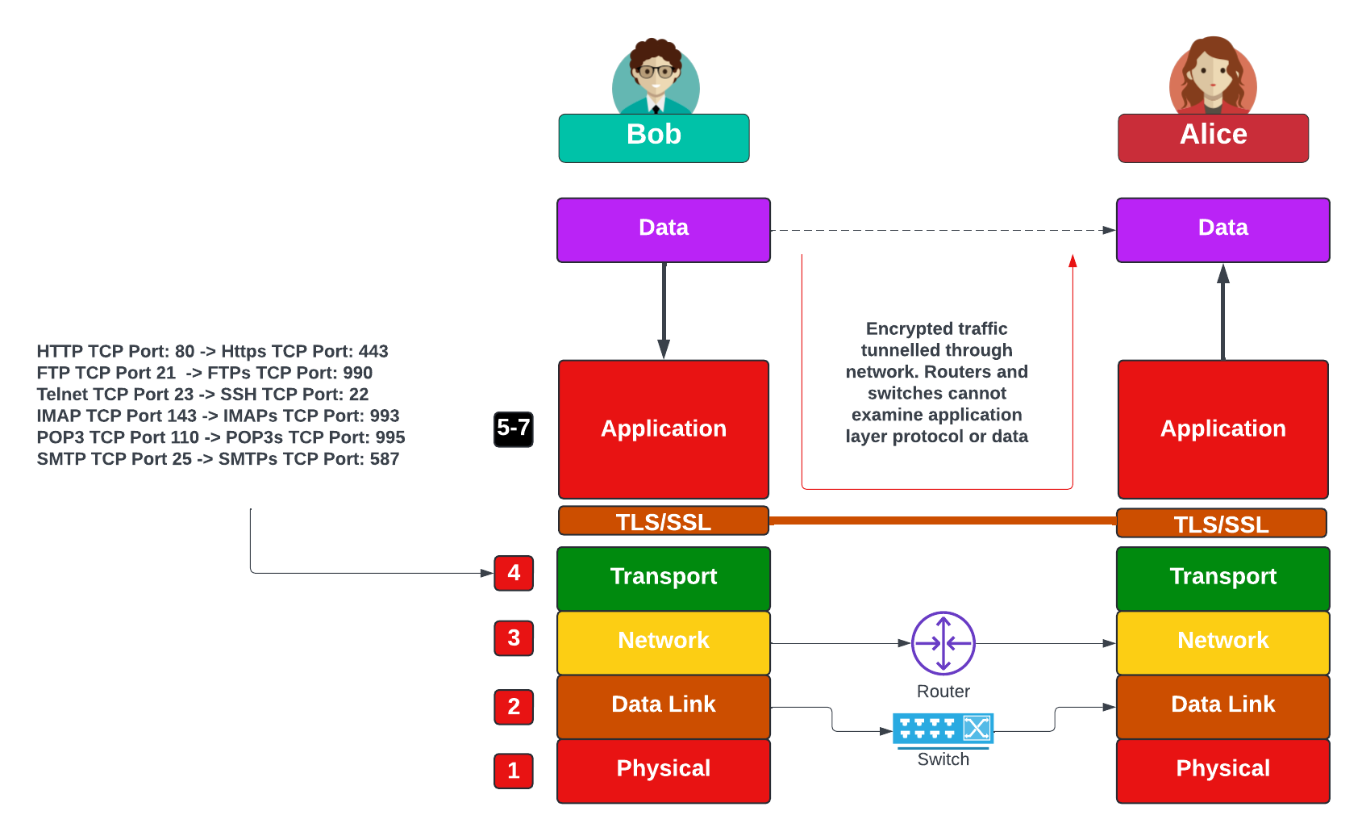
Tunneled Traffic

Slide 47
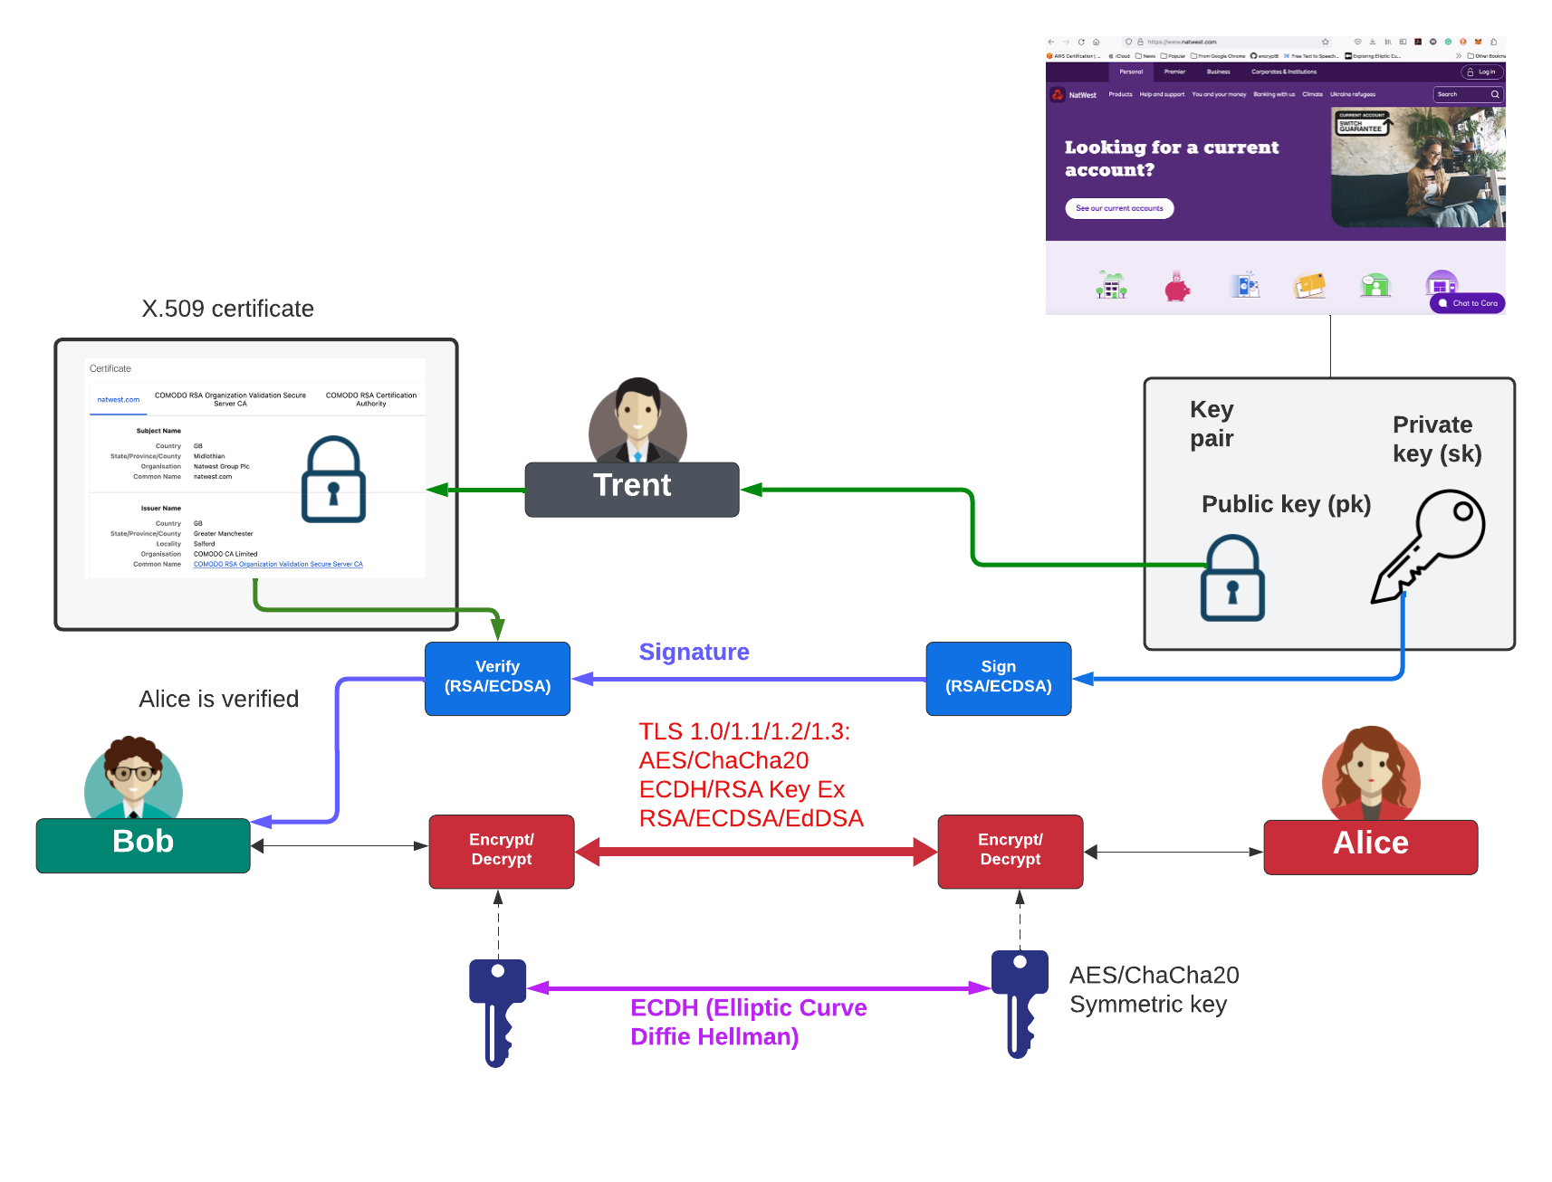
Tunneled Traffic

Slide 48
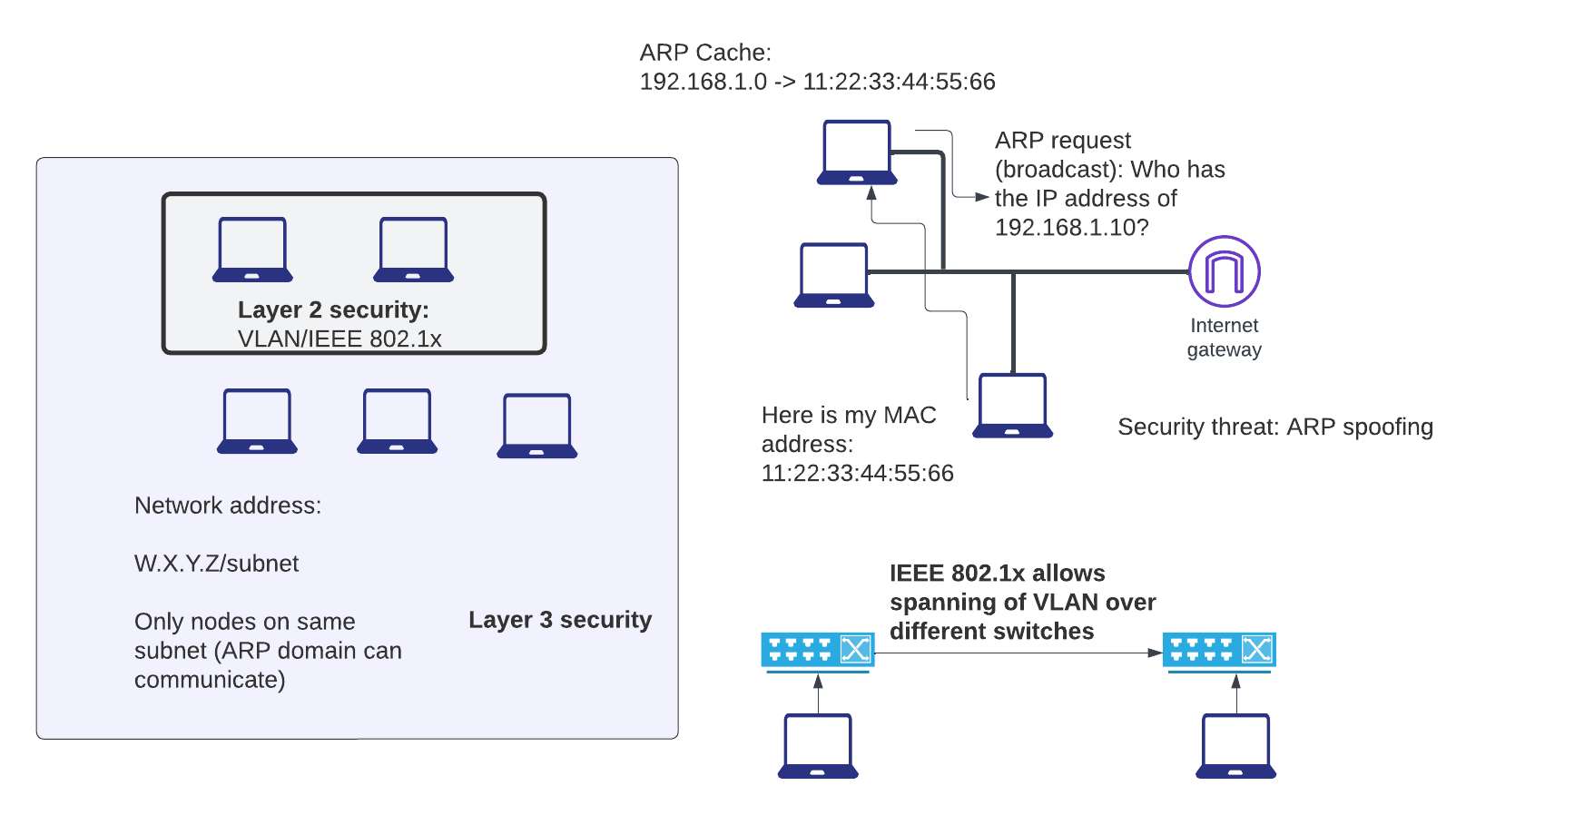
Layer 2 and Layer 3 Security

Slide 49

VPN (Virtual Private Network) Tunneling

Slide 50

Tunneled Traffic

Slide 51

Dual-homed Architecture

Slide 52

Web Application Firewall (WAF)

Slide 53

Remote Access to Device/Server

Slide 54


Pen Testing Tools

Slide 55
Secure Enclaves
“From bits to information”

Slide 56

Secure Enclaves

Slide 57

Secure Enclaves

Slide 58

Secure Enclaves

Slide 59

MITRE EMB3D (Embedded Devices)

Slide 60
NAT
“From bits to information”

Slide 61

Layered Model

Slide 62

Layered Model

Slide 63

Layered Model

Slide 64

Layered Model

Slide 65

Layered Model

Slide 66

Layered Model

Slide 67

Layered Model

Slide 68

Layered Model

Slide 69

Layered Model

Slide 70
AI Threats and Opportunities
“From bits to information”

Slide 71

AI Threats
Cyber Defence:
Cyber Defence Automation.
Cybersecurity Reporting.
Threat Intelligence.
Secure Code Generation and Detection.
Developing Ethical guidelines
Incident Response and Digital Forensics.
Identification of Cyber attacks.
Data set generation.
Social, Legal and Ethical:
Pervasive role of ChatGPT
Unauthorized access to conversations
Personal information misuse
Data ownership concerns
Misuse by organisations
Hallucinations
Attacking GenAI:
Jailbreaks
Reverse psychology
Model escape
Prompt injection.
Cyber Offense:
Social engineering.
Phishing emails
Automated hacking
Attack payload generation
Malware code generation
Polymorphic malware
Reversing cryptography

Slide 72





AI Security Frameworks

Slide 73


Bug Detection
GPT-3 found 213 security vulnerabilities. One of the better commercial tools on the market found only found 99 issues - although their tool provides context in a more structured format. After manually reviewing a random sample of 50 / 213 of the vulnerabilities detected by GPT-3, only one was a false positive. Both tools had many false negatives.

Slide 74
Defence Systems, Policies and Risks
“From bits to information”

